Slide 1
Supporting Students Through Anxiety & Depression:
Strategies for Navigating Mental Health in a Tech Heavy World
Presented By
Holly Crossen, Psy.D.
holly@hollycrossen.com

Slide 2
What is Anxiety?
Distress or uneasiness of mind caused by fear of danger or misfortune.
~Dictionary.com

Slide 3
DSM-5 Generalized Anxiety Disorder
A. Excessive anxiety and worry (apprehensive expectation), occurring more days than not for at least 6 months, about a number of events or activities (such as work or school performance).
B. The individual finds it difficult to control the worry.
C. The anxiety and worry are associated with 3 or more of the following six symptoms:
1. Restlessness, feeling keyed up or on edge.
2. Being easily fatigued.
3. Difficulty concentrating or mind going blank.
4. Irritability.
5. Muscle tension.
6. Sleep disturbance (difficulty falling or staying asleep, or restless, unsatisfying sleep).
D. The anxiety, worry, or physical symptoms cause clinically significant distress or impairment in social, occupational, or other important areas of functioning.

Slide 4
Prevalence of Anxiety Disorders:
Children aged 6–17 “Ever having been diagnosed with anxiety” increased from 5.5% in 2007, to 6.4% in 2011–2012.
Children age 3-17 “have diagnosed anxiety” 7.1% (approx. 4.4 million) most recently.
High rates of recovery with treatment: After 3-4 years, 82% no longer met criteria for their anxiety disorder. However, only 6 out of 10 receive treatment for it.

Slide 5
Anxiety in College-Aged Students
The data on anxiety among 18- and 19-year-olds is even starker. Since 1985, the Higher Education Research Institute at UCLA has been asking incoming college freshmen if they “felt overwhelmed” by all they had to do. The first year, 18 percent replied yes. By 2000, that climbed to 28 percent. By 2016, to nearly 41 percent.

Slide 6
When Is It Time To DIAL for Help?
Distress: Are they very upset when faced with the fear? Do they tolerate it with a significant amount of distress?
Interference: How much is it interfering in their day to day life?
Age Appropriate: Separation anxiety is more age appropriate for up to age 6, than it is for an adolescent in high school.
Length of Time: Have they been experiencing symptoms of anxiety for a significant amount of time (at least 6 months) and is it consistent or only happens sometimes?

Slide 7
School Related Problems From Anxiety:
Attention difficulties
Attendance problems
Frequent complaints of stomachaches/ headaches/ illnesses
Irritability, anger, and opposition
Frequent crying
Fatigue/ sleepiness
Perfectionism
Social difficulties
Alcohol and drug use

Slide 8
How are Children with Anxiety Helped?
Psychoeducation- learning about anxiety, what causes it, and how it causes the feelings in your body.
Behavioral- Learning relaxation techniques, exercise, adequate sleep, etc.
Cognitive- learning about patterns of anxious thinking and how to change them.
Graded Exposure- facing the most tolerable portion and gradually increasing to full exposure as you learn to decrease symptoms of anxiety.
Parent Training- teaching parents how to support their child when they are anxious.
Psychiatric- medication to help balance neurochemicals.
Skills- Problem-solving skills, assertiveness skills, and social skills.

Slide 9
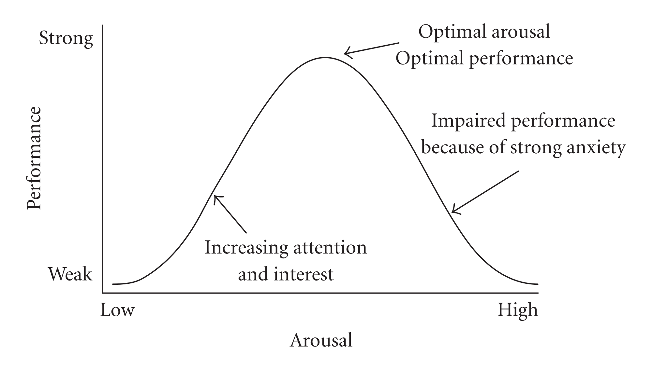
Yerkes Dodson Curve:

Slide 10
Do’s For Helping a Student With Anxiety:
Validate feelings of anxiety, but don’t endorse their feelings. Validation does not mean agreeing with them. Listen, be empathetic, and encourage the student that they can handle the situation.
Express positive, but realistic expectations. You can’t guarantee they won’t flunk a test, but you can let them know that it will be okay if they do.
Know you cannot eliminate the student’s anxiety, but work with the student and family on tools to manage the anxiety.

Slide 11
Do’s For Helping a Student With Anxiety:
Encourage the student to tolerate their anxiety. Their anxiety will drop over time as they continue to have contact with the stressor.
Try to keep the anticipatory period short. Reduce or eliminate this period. Allow them to go towards the beginning of presentations rather than last.
Help talk it through with them. If they are worried about a parent picking them up, ask them about what they would do if the parent didn’t come. Help reduce any catastrophizing.

Slide 12
Don’ts For Helping a Student with Anxiety
Don’t allow the child to avoid things, just because it makes them anxious.
Don’t reinforce fears with your body language or tone of voice.
Don’t tell them, “It’s not a big deal” or “Don’t worry.”
Don’t assume a lack of attention is due to ADHD, because anxiety can also significantly interfere with attention.
Don’t allow them to constantly talk about anxiety and worried feelings. They need to learn to put structure around it. “Worry Time.”
Don’t single the student out in class.

Slide 13
What is Depression?
Feelings of severe despondency and dejection.
~Dictionary.com

Slide 14
DSM-5 Major Depressive Episode
Five or more symptoms during the same 2-week period and at least one of the symptoms should be either (1) depressed mood or (2) loss of interest or pleasure.
Depressed mood most of the day, nearly every day.
Markedly diminished interest or pleasure in all, or almost all, activities most of the day, nearly every day.
Significant weight loss when not dieting or weight gain, or decrease or increase in appetite nearly every day.

Slide 15
DSM-5 Major Depressive Episode
A slowing down of thought and a reduction of physical movement (observable by others, not merely subjective feelings of restlessness or being slowed down).
Fatigue or loss of energy nearly every day.
Feelings of worthlessness or excessive or inappropriate guilt nearly every day.
Diminished ability to think or concentrate, or indecisiveness, nearly every day.
Recurrent thoughts of death, recurrent suicidal ideation without a specific plan, or a suicide attempt or a specific plan for committing suicide.

Slide 16
Prevalence of Depression
Ages 6-17:
“Ever having been diagnosed with either anxiety or depression” increased from 5.4% in 2003, to 8% in 2007, and to 8.4% in 2011–2012.
“Ever having been diagnosed with depression” did not change between 2007 (4.7%) and 2011-2012 (4.9%), but did recently to 8.1%.
Suicide is the third leading cause of death among 15-19-year-olds.

Slide 17
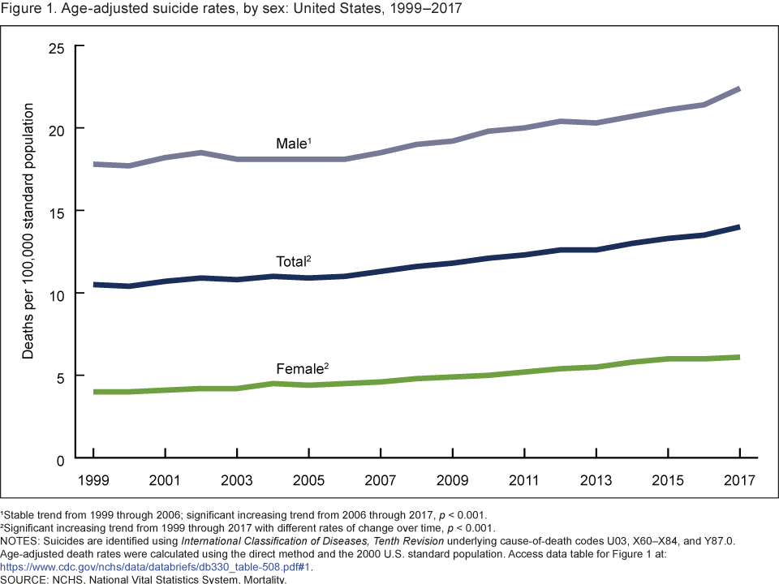
Suicide Rates Across Time

Slide 18
School Related Problems From Depression
Attention difficulties
Attendance problems
Frequent complaints of stomachaches/ headaches/ illnesses
Irritability, anger, and opposition
Frequent crying/ easily overwhelmed
Fatigue/ sleepiness
Lack of motivation, slow work completion, missing assignments
Isolation and withdrawal
Pessimism/ self-deprecating comments

Slide 19
How Are Students with Depression Helped
Cognitive Behavioral Therapy (CBT) helps teens to identify and modify thought and behavior patterns, shifting them from the negative toward the positive.
Dialectical Behavioral Therapy (DBT) helps teens acknowledge the unhealthy behaviors they are using to cope with deeper underlying issues, and develop ways to modify these behaviors. This behavioral modification helps alleviate depression in school.
In psychoeducation groups, clinical professionals educate teens on how the brain works, so they can begin to change their thought processes and increase overall mental health.

Slide 20
How Are Students with Depression Helped
Acceptance Commitment Therapy (ACT) combines acceptance and mindfulness strategies with commitment and behavior-change strategies to increase psychological flexibility.
Multi-Dimensional Family Therapy (MDFT) engages teens through a family-centered approach, empowering teens and their family members.
Person-Centered or Humanistic Therapy engages teens using unconditional positive regard, compassion, and empathy, so they feel accepted and can better understand their own feelings.
Psychiatric- Medications are prescribed to help balance neurochemicals

Slide 21
Do’s For Helping A Student With Depression
Validate the student’s experience and feelings (“I know that things are really hard for you right now”)
Develop a Working and Collaborative Relationship: Do not be afraid to talk with depressed students about how they feel. Many times, they are seeking someone who cares about them. Keep open communication with their parents.
Be supportive and look for opportunities for your student to succeed in the classroom.
Incorporate physical activities into daily classroom instruction, which can help ease a student's depression symptoms, as well as energize all of your other students.
Help the student to identify automatic negative thoughts and strategies for reframing these negative thoughts; encourage positive self-talk.

Slide 22
Do’s For Helping a Student With Depression
Place the student in a brightly lit area in close proximity to instruction.
Identify student’s interests and preferred activities and try to incorporate them into his/her daily schedule.
Initiate conversations with the student when they arrive, leave, and/or take a break
Develop modifications and accommodations to respond to the student's fluctuations in mood, ability to concentrate, or side effects of medication. Give more time, break assignments into smaller pieces, offer extra help in setting up schedules or study habits.
Incorporate choice to increase interest and motivation.

Slide 23
Don’ts For Helping a Student With Depression
Don’t use negative techniques. Strategies such as punishment, or other negative techniques are not effective and likely will only reinforce feelings of incompetence and low self-esteem, which may deepen the depression.
Don’t use sarcasm, or disparagement, which can also deepen low self-esteem and depression.
Don’t ignore their struggles, or allow them to isolate.
Don’t focus on accuracy, but instead focus on effort.
DON’T GIVE UP ON THEM!

Slide 24
Activity:
Get a pen and paper

Slide 25
Why Are We Seeing More Anxiety and Depression?
Shifts in attitudes and willingness to seek help.
Changes in pressures, demands and expectations at school.
Social media and technology impair social abilities and increase isolation.
Parental overinvolvement and “bubble wrapped” kids, which increases dependency and emotional fragility.
Need for instant gratification: difficulties delaying gratification and with “boredom”

Slide 26
Lack of Practice and Skill Development
Children need to be encouraged to face challenges, take on responsibilities and accept the consequences of their actions.
Over-protected children aren't allowed to confront their problems on their own, so they never develop confidence in their own coping skills. These children grow up feeling just as helpless, overwhelmed and without agency as those who were traumatized when young.

Slide 27
Prepare the child for the road, not the road for the child!

Slide 28
The Great Cell Phone Debate: Pros
Kid tracking for parents/ peace of mind.
Instant Video Access: “I Have a Dream” Speech
Research
Calculators
Social learning for shyer students
Can help with organization
A ban avoids a teaching moment

Slide 29
The Great Cell Phone Debate: Cons
EPA concerns about harmful effects (Radiofrequency exposure)
Inappropriate materials/ cyberbullying/ predators
Distraction from school work
Interferes with social interactions
Provides a disconnect/ escape route/ poor coping
Cheating
Leads to anxiety and depression
Socioeconomic disparity: phone/ internet
Multitasking is leading to worsening attention

Slide 30
Effects
Students spending up to 20% of their in-class time texting, emailing, and checking social media. Leads to more out of class studying/ work.
Americans check their phones every 12 minutes.
Research has found that some individuals experience intense anxiety when separated from their phones, and some even exhibit withdrawal-like symptoms if they can't check their device.
Smartphones and slot machines have something in common. You know it well: that frisson of anticipation you feel whenever you pick up your phone. “Intermittent rewards”
Our phones are altering our brains.

Slide 31
Research:
Beneson Strategy Group: 35% of students admitted to cheating with their cell phones. Over 50% said they used the internet to cheat.
The Journal Educational Psychology: Students who had cellphones or laptops present while the same lesson was being taught by the same professor scored five percent, or half a letter grade, lower on exams than students who didn't use electronics. Even in the group who could, but didn’t the others’ use distracted them into getting lower grades.
Kent State University: A study of 500 undergraduate students found there was a negative relationship between frequent cell phone use and grades, as well as lower life satisfaction, increased anxiety, and poor physical health.

Slide 32
Research cont.
Dr. Nancy Cheever, California State: Relationship between cellphone use and anxiety. The more people use their phone, the more anxious they are about using their phone. Phone-induced anxiety operates on a positive feedback loop. Phones keep us in a persistent state of anxiety and the only relief is to look at our phones. Teens may be on their phones for more than six-and-a-half hours a day.
Nancy Colier, The Power of Off: Found in talking to teenagers if it's 'My heart rate is higher' versus 'I have a social life,’ they're going to choose social life.
Dr. Jon Elhai investigated the relationship between problematic smartphone use and symptoms of anxiety and depression. He reviewed 23 studies. The more participants used their smartphones, the more likely they were to experience symptoms associated with these disorders and report being stressed.

Slide 33
How to Manage Technology in Schools
4500 brain scans have shown children who use screens more than 6 hours a day are showing a premature thinning of the cortex, which is the part of the brain responsible for interpreting information from the physical world.
The same research showed that children with more than 2 hours of screen time a day scored lower on thinking and language.

Slide 34
Guidelines
There should be a schoolwide policy for screen time that is based on current research. If individual teachers make their own rules, the students are very likely to get at least 2 hours of screen time at school, which is causing permanent changes to the brain and skills on these children.
Students should only be allowed to use screens as a resource, or for calculations. Find interactive games/ activities, rather than screen activities.
Screens should not be allowed during social interaction times. They need to develop these skills.

Slide 35
Guidelines: Less Screens, More Movement
Research says that 80% of blood pools in hips after just 20-30 minutes of sitting (Blaydes, 2000). If the blood is in the hips and not the brain, then learning can be more difficult. Regardless of age, learners need to move every 30 minutes.
Brain scans show that children learn best when they are actually moving and learning at the same time. Movement stimulates the necessary neurons and electrical wiring that facilitates the child’s ability to take in information and learn. We grow new brain cells when we are physically active. [Hippocampus]

Slide 36
Activity #2
I didn’t say she took the money.

Slide 37
Questions?

