Slide 1
Academic Language

Slide 2
What is it?
The language associated with a particular content area
Needed to develop an understand the concepts and communicate that understanding
Can be oral and written

Slide 3
Academic Language
Consists of:
Vocabulary (unique and /or unique definitions)
Syntax (organization – phrasing, graphs, tables…)
Discourse (how people communicate in the discipline—specific language structures)
Function (organizational strategies—analyze, cause/effect…)

Slide 4
From Jeff Zwiers we learn: Academic Language
Cogitate
Obviate
Decontextualize
Building Academic Language: Essential Practices for Content Classrooms, 1st Edition (2008).
San Francisco, CA: Jossey-Bass

Slide 5
Bricks
quadratic

Slide 6
Mortar
Additionally

Slide 7
Abstract Words
Justice
Nominalization
Fruition
Irrational Numbers
Cauterization
Allegra

Slide 8
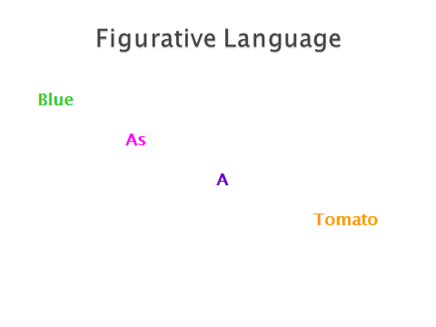

Slide 9
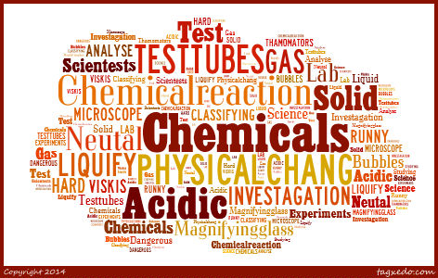
Some Problems with Academic Language Specifically in Mathematics/Science
Vocabulary

Slide 10
What comes to mind when I say the following?

Slide 11
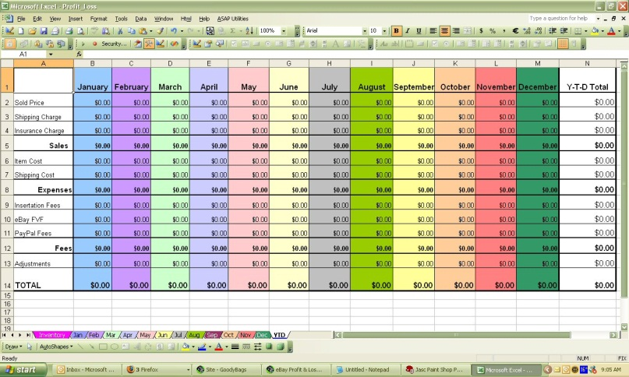
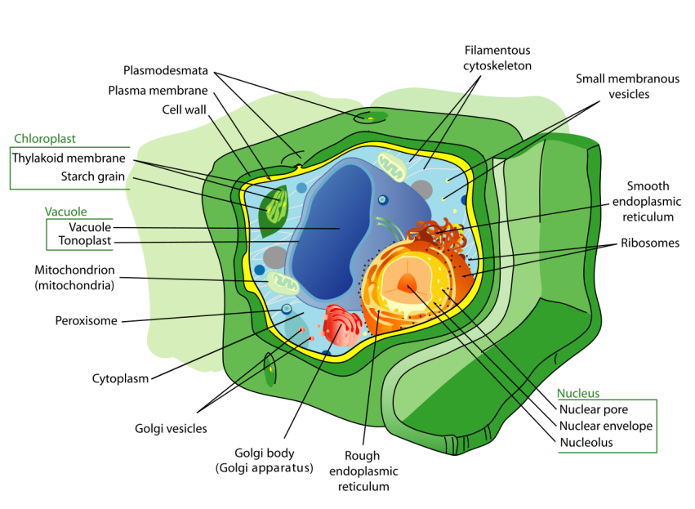

Slide 12
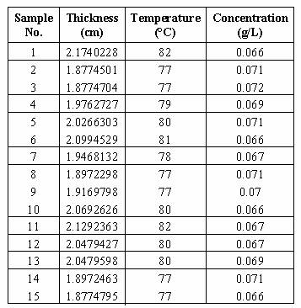

Slide 13
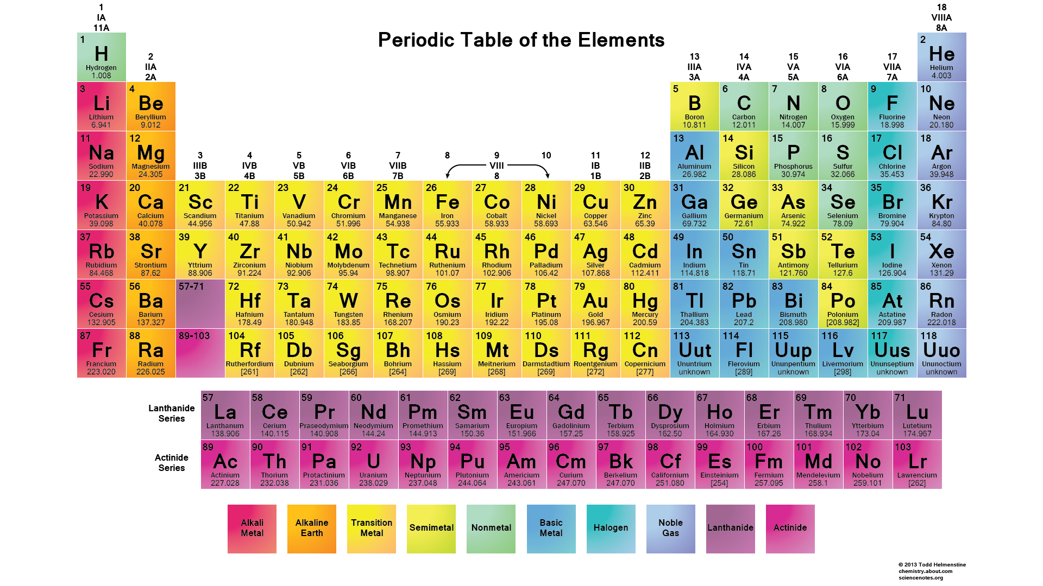
Or these
Symbiosis
Photosynthesis
Hemoglobin
Histogram
Diffraction
Titrate
Chromatography
Hypotenuse
Differential
Prime factor

Slide 14
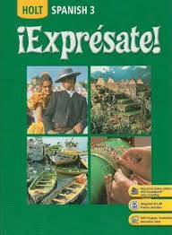
About 2000-2500 new words

Slide 15
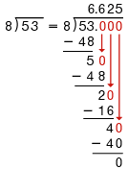
Syntax
53÷8

Slide 16
The number x is 10 less than the number y.*
*Iruno, S. (2007). So just what is the academic language of mathematics? The ELL Outlook, May/June 2007.

Slide 17
The number x is 10 less than the number y.
X

Slide 18
The number x is 10 less than the number y.
X=

Slide 19
The number x is 10 less than the number y.
X=10

Slide 20
The number x is 10 less than the number y.
X=10-

Slide 21
The number x is 10 less than the number y.
X=10-y

Slide 22
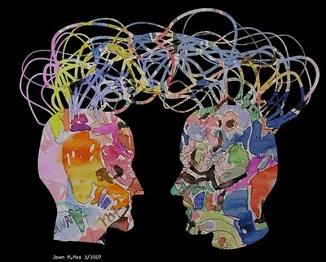
Discourse

Slide 23
Any “problems” with this?
A submarine is 285 feet under the surface of the ocean. A helicopter is flying at 4,500 feet above sea level. Given that the helicopter is directly above the submarine, how far apart are they?
Sea level and surface of the ocean are used as synonyms.
Sea level is abstract—can measure things on land and places, for example New Orleans, can be below sea level and not be underwater.
How far apart—is that horizontal or vertical distance?
“Given that” is discourse familiar to math, not everyday language
What does “they” refer to—people or things? Who is they is this problem?

Slide 24
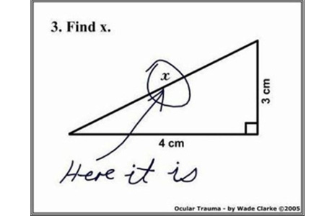

Slide 25
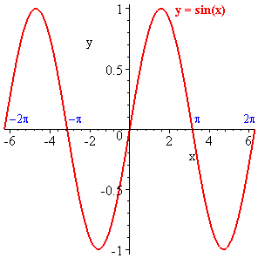
Functions
Laid out in CCSS-M and NGSS, particularly in practices and problem solving

Slide 26
Lots of overlap among ELA/Science/Math/Social Studies
Infer
Interpret
Justify/Evidence
Label
List
Make a claim
Measure
Model
Plan
Summarize
. . .
Analyze
Apply
Classify/Sort
Compare/contrast
Conclude
Describe
Distinguish
Explain
Evaluate
Generalize

Slide 27
Writing in Math and Science!!
Descriptive – used in observations
Persuasive – convince your interpretation is valid; claims/evidence
Expository – communicating accurate representations of ideas and explanations (e.g., explaining procedures, writing newspaper articles)
Narrative – generally in “make believe” writing (e.g., pretend you are a water drop…..)

Slide 28
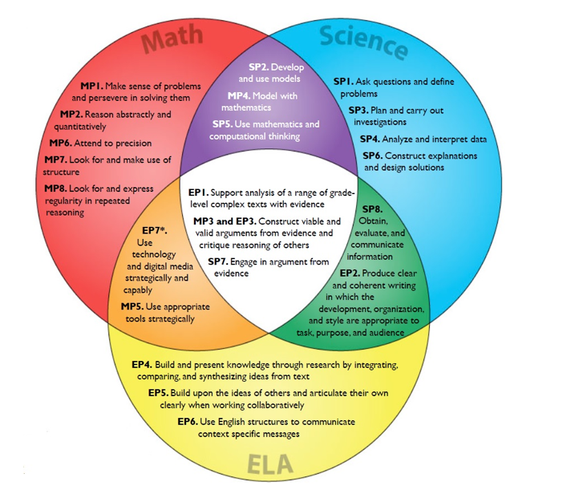

Slide 29
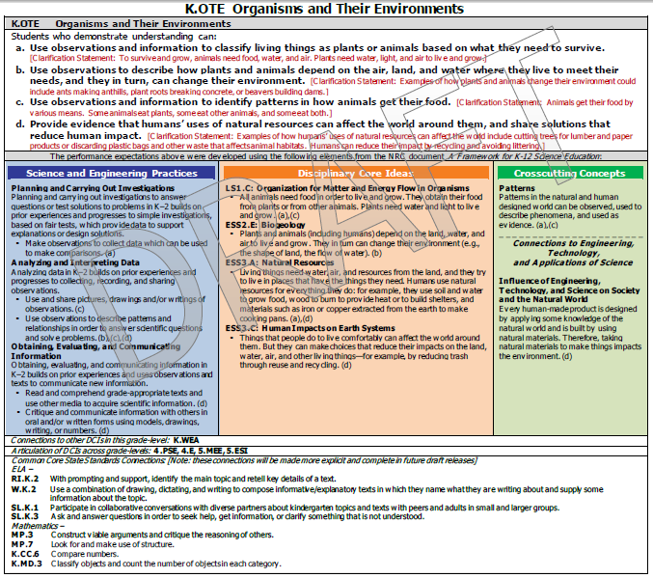

Slide 30
Academic Language
Provides for greater integration
And integration that isn’t forced

Slide 31
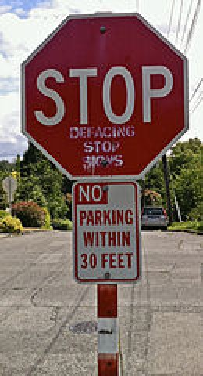
Irony

Slide 32
Onomatopoeia

Slide 33
Naturalism

Slide 34
Academic Language: Social Studies/History and Summary Thoughts

Slide 35
Vocabulary in Social Studies
General words with specific subject meaning
Branch of government
Cycle
Depression
Market
Inflation
Revolution
General academic vocabulary
Discover
Cause
Paradigm

Slide 36
Vocabulary in Social Studies
Discipline Specific Words
Longitude
Latitude
Medieval
Nation

Slide 37
Language Function in Social Studies
language representing thinking-learning tasks/processes.
- a way of thinking about & with content
- a specific task we do with content

Slide 38
Language Function in Social Studies
Examine
List
Explain
Interpret
Categorize
Analyze
Infer
Evaluate
Predict

Slide 39
Syntax and Discourse in Social Studies
Syntax
Conventions for organizing language in structures
Discourse
The structures of language used for knowledge construction/communicating ideas

Slide 40
Syntax and Discourse in Social Studies
Discourse
Historical account
• time sequence
• frequency
Syntax
Initially
previously
Later
first, second, finally
In the past
Sometimes
Few
Many
Occasionally
Frequently

Slide 41
Syntax and Discourse in Social Studies
Discourse
Historical Explanation
• cause and effect
• significance
• relationships
Syntax
as a result of
Reaction to
contributed to
the most important..
the least important…
maximum
minimum
However,
Paradox
an example of
similar to

Slide 42
Syntax and Discourse in Social Studies
Discourse
Historical Argument
• prediction/conclusion
• point of view
Syntax
possibility
proves
Therefore
above all
Perspective
bias

Slide 43
Some Concluding Thoughts about Academic Language
More than Vocabulary
ways of thinking and acting
means of expression
• Children naturally know how to do some disciplinary thinking and acting.
most need to learn the language for this
• Academic Language is an Equity/Justice Issue

Slide 44
School is where you go to learn a secret language but they don’t tell you that its there. You have to figure it out on your own. Its like an initiation to a secret club.
Maya, 8th Grade
Notes:
Experts in a discipline have implicit knowledge/understanding of academic language.
Some students have some implicit knowledge/understanding of academic language.
Some students have no implicit knowledge/understanding of academic language.

