Slide 1
Is p < .05?
Notes:
Jackie

Slide 2
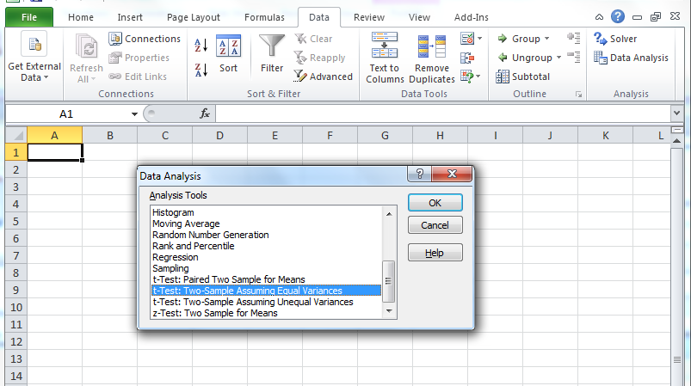
How to use Excel to do this Yourself

Slide 3
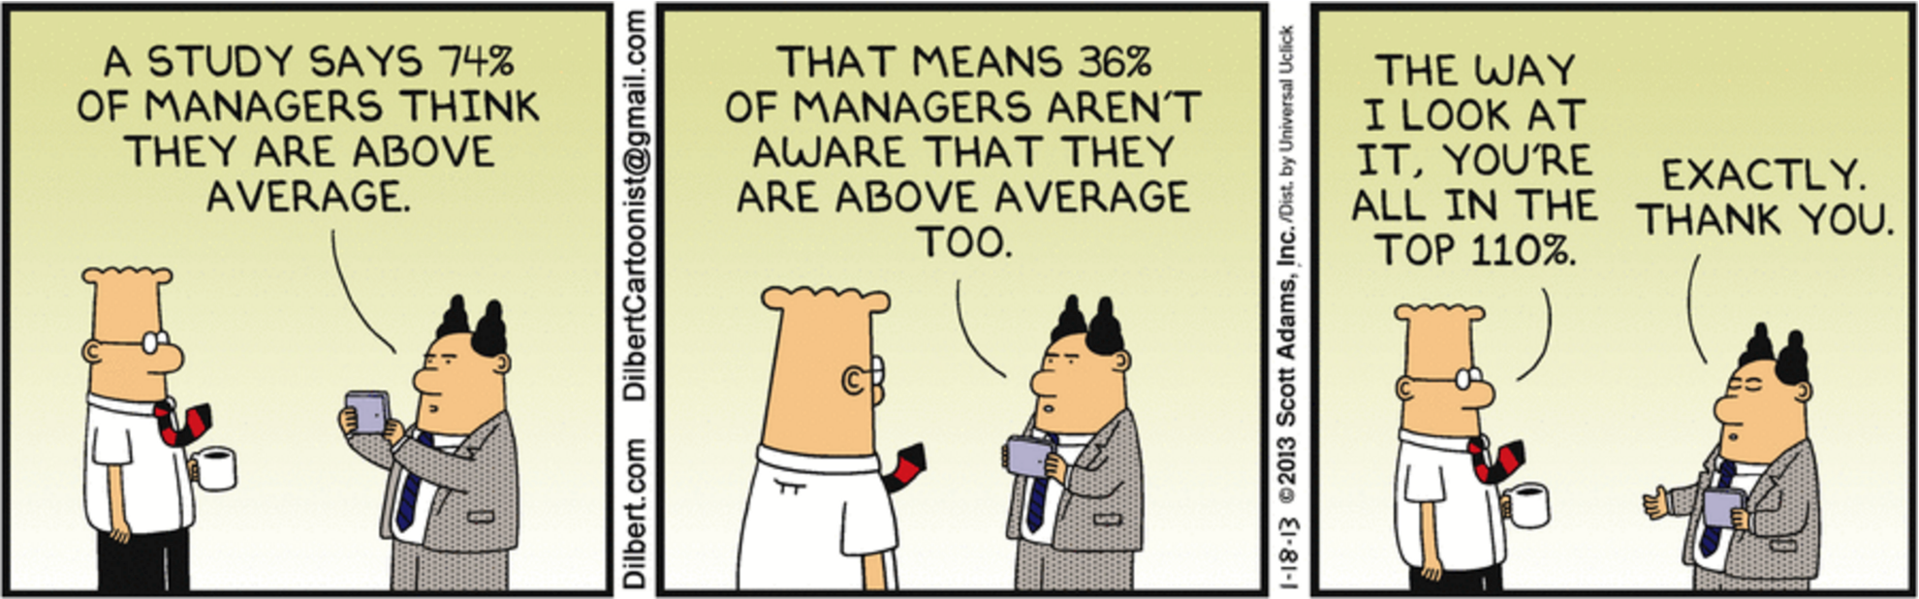
Notes:
Jackie-We want teachers and administrators to be intelligent consumers of data and research.

Slide 4

Tip #5: Having a map will help.
Notes:
Nicole

Slide 5
Make a plan. Collect data with the plan in mind.
Notes:
Nicole

Slide 6
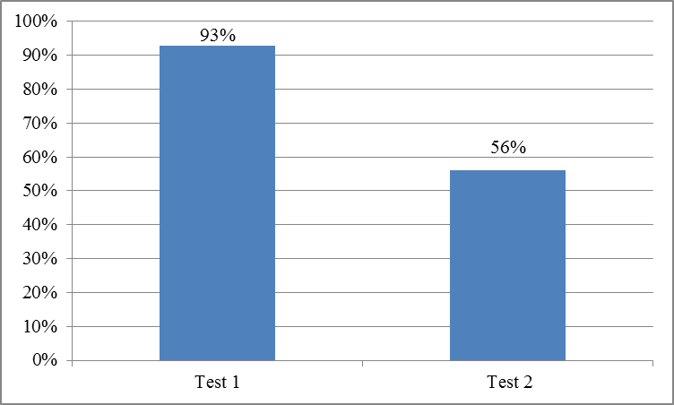
A Tale of Two Tests
Notes:
Nicole
What do you notice?

Slide 7
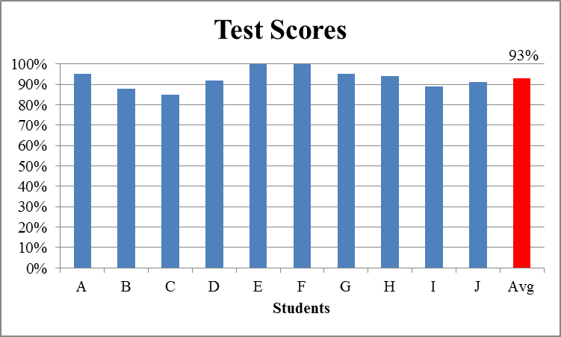
Test #1
Notes:
Nicole

Slide 8
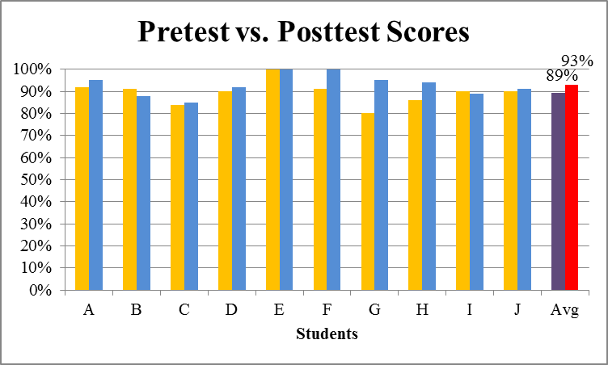
Test #1
Notes:
Nicole
Think of how much time you just wasted teaching this unit.

Slide 9
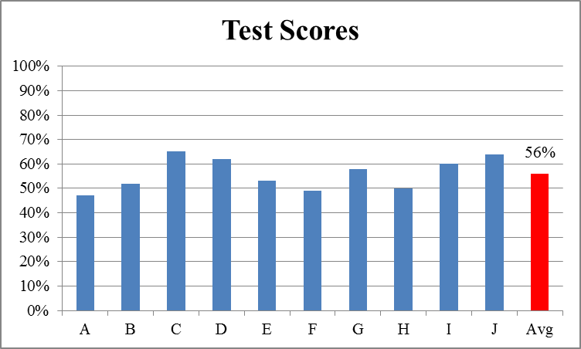
Test #2
Notes:
Nicole

Slide 10
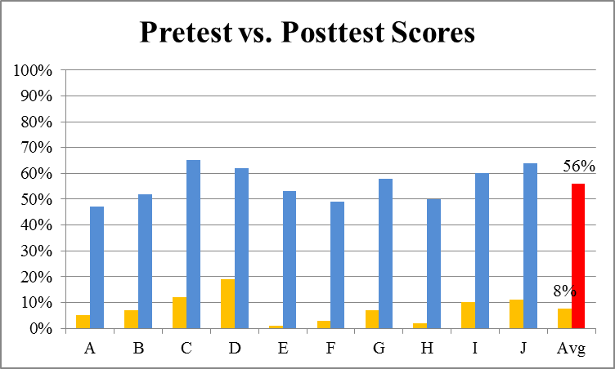
Test #2
Notes:
Nicole

Slide 11
Statistically Significant?
Paired Samples t-test
Test 1
Test 2

Slide 12
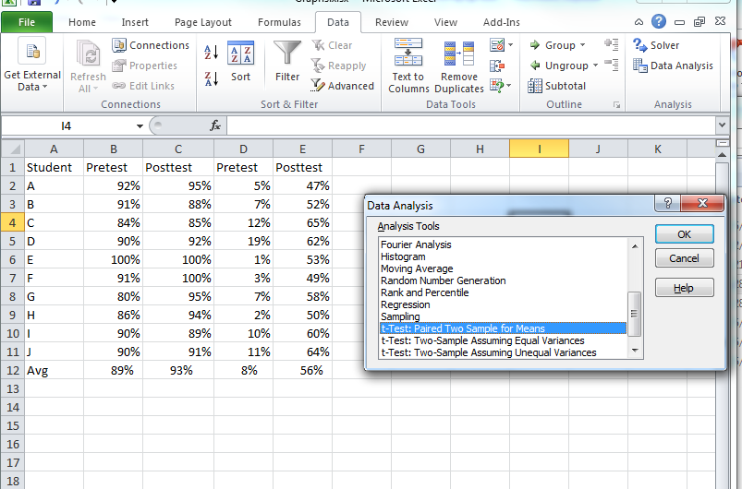
How to use Excel to do this Yourself

Slide 13

Tip #6: Preventative maintenance saves in the long run.
Notes:
Jackie-Must think of how you will analyze the data before you collect it—garbage in; garbage out. Are the data in the form you’ll get results? Did you pilot the survey? What kind of test of significance will you conduct?

Slide 14
“Strengthening the practice of formative assessment produces significant and often substantial learning gains.”
- Black & Wiliam, 1998
Notes:
Jackie – The goal of formative assessment is monitor student learning during the learning process in order to modify teaching and learning activities to improve student attainment (remember the slide about the map).

Slide 15
“Formative assessment has a disproportionately beneficial impact on low-achieving students.”
- Black & Wiliam, 1998
Notes:
Jackie

Slide 16
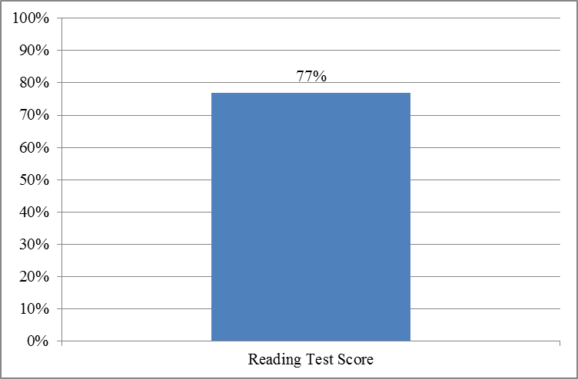
Making Instructional Decisions
Notes:
Jackie - What instructional decisions would you make based on these data?

Slide 17
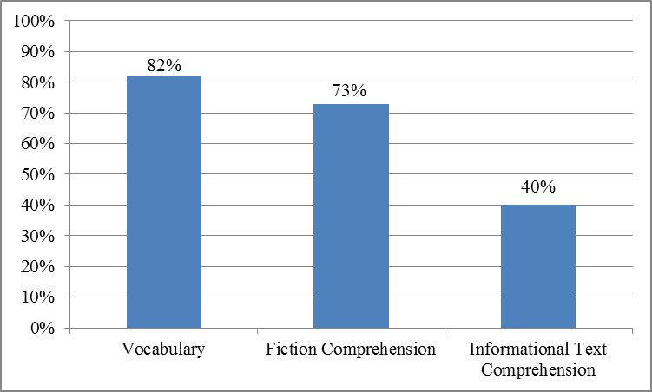
Making Instructional Decisions
Notes:
Jackie
What instructional decisions would you make based on these data?

Slide 18
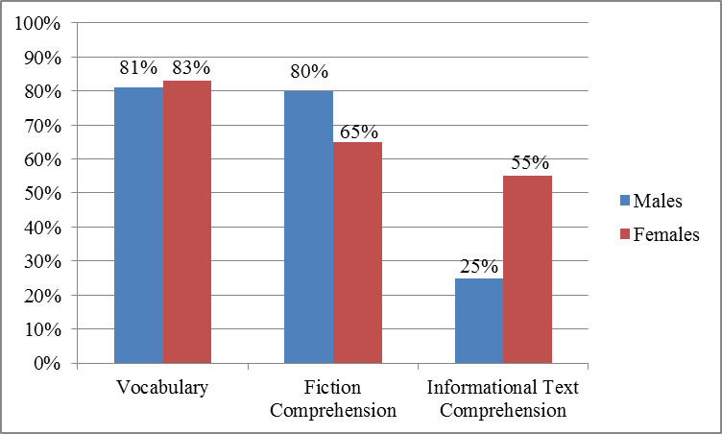
Making Instructional Decisions
Notes:
Jackie
What instructional decisions would you make based on these data? Get more fine grain analysis.

Slide 19
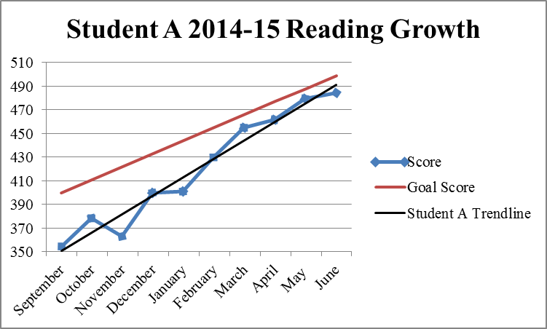
Making Sense of the Data
Notes:
Jackie-Growth Matters

Slide 20
Save Your Sanity
Have a “teaching buddy”
  Share the workload
Don’t reinvent the wheel – use resources!
  Rubistar
  Google it!
Notes:
Jackie-rubistar.4teachers.org “Google it” Google Scholar

Slide 21
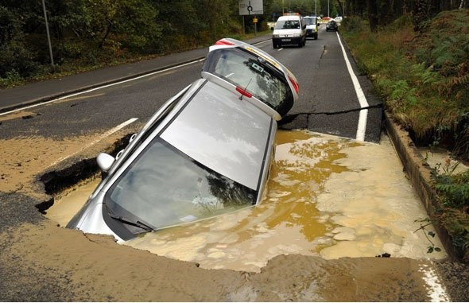
Tip #7: Potholes can trip us up.
Notes:
Nicole

Slide 22
You don’t know what you don’t know until you know it.
Notes:
Nicole

Slide 23
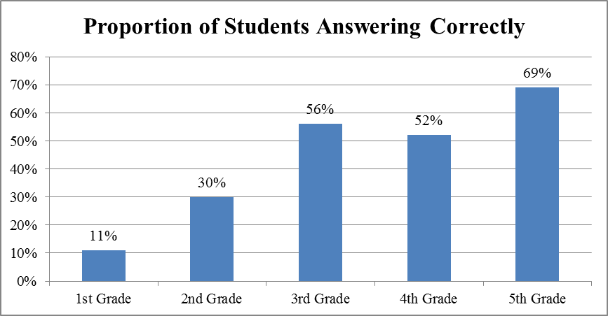
8 + 4 = + 5
Notes:
Nicole

Slide 24
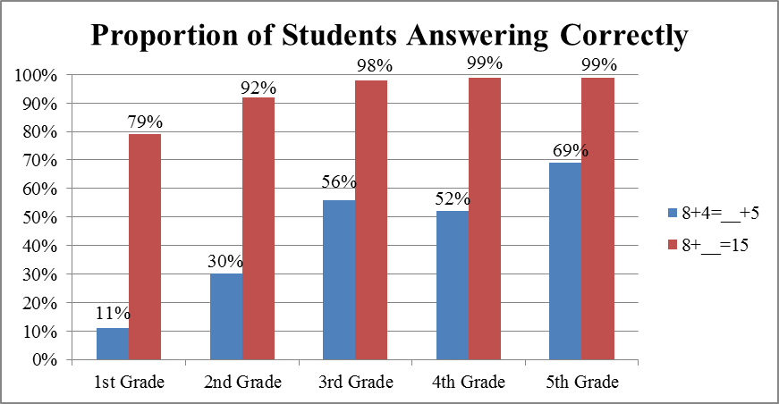
But That’s Not the Whole Story
Notes:
Nicole

Slide 25
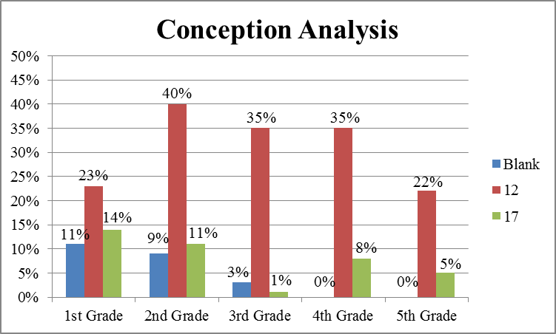
But That’s STILL Not the Whole Story
Notes:
Nicole

Slide 26
The Problem
Students often interpret the equal sign operationally instead of relationally
Notes:
Nicole

Slide 27
All errors are not created equally. Diagnose!
Notes:
Nicole

Slide 28
Think of potholes as opportunities to deepen learning.
Notes:
Nicole

Slide 29
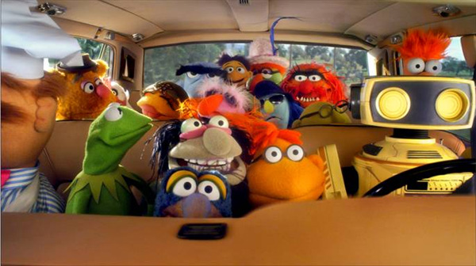
Tip #8: Make the journey FUN!
Notes:
Jackie

Slide 30
Data Begin with a Question
What questions would you like to ask to improve your classroom’s conditions, instruction, and student learning?
Notes:
Jackie-Template? Time in groups? 30 seconds per person to share, can say “Pass”

