Slide 1
Driving With Your Eyes Closed: How to See the Road Through the Data
Dr. Jacqueline Waggoner, Ed.D.
Dr. Nicole Ralston, Ph.D.

Slide 2
Opening Activity
5 people at your table have “jobs.” Everyone else is an “observer” (get your directions).
(Please put up your name tent)
Do NOT open your envelope until we say GO!”
Notes:
Nicole

Slide 3
Broken Squares
Pass out the purple pieces evenly amongst your 5 participants.
When we say “GO,” your group is to form five squares of equal size. Each individual in the group must have a perfect square of the same size as everyone else’s square.
Notes:
Nicole

Slide 4
Broken Squares Rules
No member may speak or signal.
No member may ask for another piece or make a signal.
No member may take a piece from another member.
However, members may give their pieces to other members.
(Observers will enforce the rules)
Notes:
Nicole

Slide 5
Go!

Slide 6
Discussion Questions
How did you feel during this exercise? Why?
Observers: What did you notice?
Was there any critical point at which the group started to cooperate? What was the cause?
What are some principles for a successful group?
How does this relate to us in the context of our “job”? In the context of understanding data?
Notes:
Nicole

Slide 7
Tip #1: If you want to go fast, go alone. If you want to go far, go together.
Notes:
Nicole – Bridging activity to the Tip. Here’s the first Tip – and you’ll notice the lovely team - Turn and talk at your tables about how this Tip relates to not only the activity, but also how it relates to data.
A VERY important person was missing from the “roles” at the table – who was it?

Slide 8
Students Can be Drivers, Too
Self-assessment activates learners as owners of their learning
Empowers students
Notes:
Nicole

Slide 9
Students Can be Drivers, Too
Teach students to examine their own data and set learning goals
Explain expectations and assessment criteria
Share strong and weak examples
Provide feedback
Notes:
Nicole

Slide 10
Students Can be Drivers, Too
Feedback has one of the strongest effect sizes on student learning
ES = .75
Feedback can double the rate of learning (Wiliam, 2011)
Notes:
Nicole

Slide 11
Students Can be Drivers, Too
But it has to be done RIGHT
Be specific
Be timely
Be constructive
Present it CAREFULLY
Involve the learner; opportunity for dialogue
Notes:
Nicole

Slide 12
Students Can be Drivers, Too
Grades tend to diminish interest, create a preference for the easiest task, and reduce quality of student thinking
Feedback is helpful only in the absence of grades
Provide feedback that moves learning forward
Notes:
Nicole

Slide 13
Strength & Growth
Notes:
Nicole

Slide 14
Stars & Stairs
What I do well
What I can do next

Slide 15
Learning from Mistakes
Notes:
Nicole

Slide 16
Learning from Mistakes
Problem | Learning Target | Right | Wrong | Fixable Mistake | Don’t Get it
1 | Identify elements of story – plot | X
2 | Identify elements of story – setting | X
3 | Identify elements of story – characters | X
4 | Describe a character’s actions based on text evidence |  | X | X
6 | Recognize similes in context |  | X |  | X

Slide 17
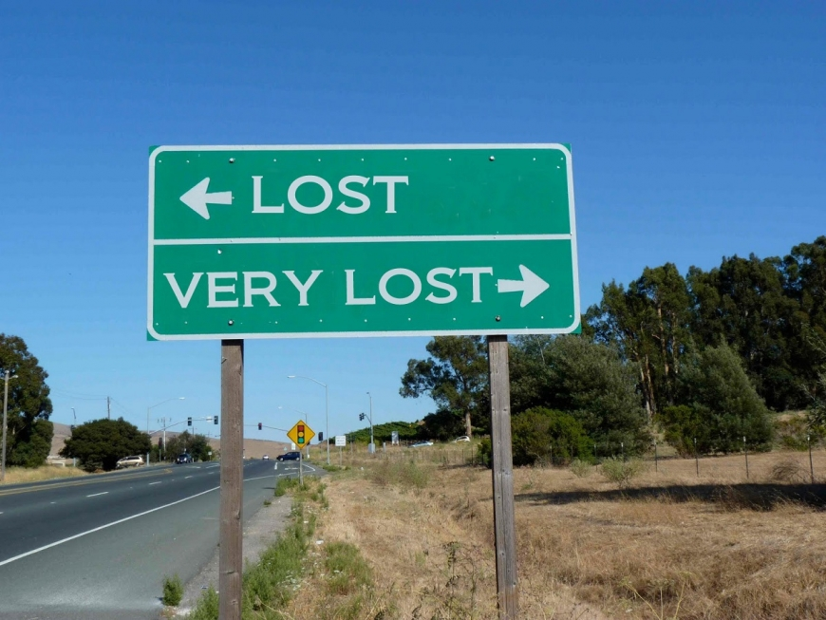
Tip #2: We can easily get lost (in the data).
Notes:
Jackie

Slide 18
“Until you have data as a backup, you are just another person with an opinion.”
- Dr. Perry Gluckman
Notes:
Jackie-rather self-explanatory

Slide 19
Notes:
Jackie What does it mean? Turn to your neighbor, and talk about why it is important to put faces on the data.

Slide 20
Data are People, Too!
Student | Gender | Science | Grade
1 | Female | 239 | 9
2 | Male | 242 | 11
3 | Female | 263 | 12
4 | Male | 239 | 10
5 | Female | 245 | 9
6 | Male | 247 | 9
7 | Female | 244 | 11
8 | Female | 243 | 12
9 | Male | 253 | 12
10 | Female | 239 | 10
11 | Male | 247 | 11
12 | Female | 242 | 10
13 | Female | 245 | 10
14 | Female | 236 | 9
15 | Male | 244 | 9
16 | Male | 239 | 9
17 | Female | 242 | 11
18 | Male | 263 | 12
19 | Female | 276 | 10
20 | Female | 245 | 9
Notes:
Jackie-These are people—faces. Close your eyes and think of a child in your classroom or school.

Slide 21
Teachers are Researchers
Make data part of an ongoing cycle of instructional improvement.
Collect a variety of data (multiple measures) about student learning.
Interpret data and develop hypotheses about how to improve student learning.
Modify instruction to test hypotheses and increase student learning based on the data.
Notes:
Jackie-we want EACH student to learn. How do we know each student is learning?

Slide 22
Data “Should” be All Around Us
Analyze results of pretest/posttests
Quizzes
Class projects
Classwork and homework
Attendance records
Family meetings and phone calls
Behavior
IEP’s
Cumulative files
Conversations
Surveys
Observations
Notes:
Jackie

Slide 23
Multiple Measures of Learning
Visible Learning for Teachers (Hattie, 2011)
Hattie effect sizes-138 influences & effect sizes across all areas related to student achievement
Six areas that contribute to learning
The student
The home
The school
The curricula
The teacher
The teaching and learning approaches
Notes:
Jackie-According to John Hattie Visible Learning and Teaching occurs when teachers see learning through the eyes of students and help students become their own teachers. Teachers become evaluators of own teaching. Fifteen-yr rsrch prjk synthesizing 50,000 studies.

Slide 24
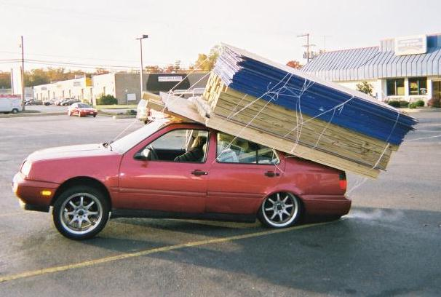
Tip #3: Choose the right car for the job.
Notes:
Nicole – rent a uhaul!

Slide 25
Tired of “Quizzes”?
Exit tickets
Whiteboards
Doodle it
Twitter voting
Socrative
Quiz, Quiz, Trade
Same quiz questions in Easter eggs or as posters or…??
Reflections
Kahoot
Concept maps
Quick Writes
Misconception Check
Colored Cups
Write 3 summaries
10-15 words
30-50 words
75-100 words
Notes:
Nicole

Slide 26
Plickers
Notes:
Nicole

Slide 27
Poll Everywhere
Notes:
Nicole

Slide 28
Don’t Forget: Data are So Much More than Just Test Scores
Knowledge isn’t the only thing that’s important
Consider social-emotional learning, mindset, engagement, and interest
How might you assess these?
Notes:
Nicole – Turn and talk to your table mates about ways you currently do (or could start) assessing these types of important, non-academic skills

Slide 29
If You’re Not Going to Use It, Don’t Collect It!
Notes:
Nicole
Although car collectors might not agree… It’s not efficient, it wastes their time, it waste your time. Have a purpose, backwards planning.

Slide 30
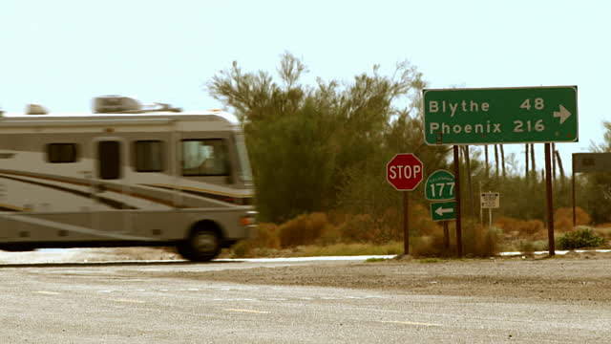
Tip #4: Know the difference between “far” and “really far.”
Notes:
Jackie –Just like effect size, Hattie found that almost any intervention can claim to “work.,” as it has an effect size > 0. The mean achievement of one intervention can be greater than of another, but….

Slide 31
Statistically Significant?
Is there a “real” difference between group means?
Could this difference be due to chance?
Notes:
Jackie

Slide 32
Notes:
Jackie result of an Excel Indep t-test.

