Slide 1
Prioritizing the Common Core:
Focusing your energy where it matters in the 6-12 math classroom
January 15, 2015
Shannon Parvankin
parvankin@gresham.k12.or.us
@SParvankin
Notes:
Gauge MS vs HS – Tchrs vs Admin – Team vs 1-2
Presentation stems – Citing Evidence

Slide 2
Targets
I have a clearer picture of where to focus my instruction.
I have 3 strategies I can take back to my classroom that will enhance my instruction of the common core state standards.
Stemming the math talk
Close Reading with I Notice - I Wonder
Engaging in Critical Thinking - Framing

Slide 3
Target
I have a clearer picture of where to focus my instruction.
Strategy #1
Stemming the math talk
Notes:
Stemming the math talk - Use presentation stems to ask questions or comment.
Citing evidence is an ELA instructional shift and is evident in our math shifts (Rigor) and practice standards (#3).
When we introduce stems in class, it is best to start with one or two for a couple of weeks, then introduce another one or two. This way, kids can practice the language. Language is mechanical before it becomes internalized.

Slide 4
Shift 1: Focus
Common Core
Summary of major work 6-8
Publisher’s Criteria for High School 11
Smarter Balanced
Prioritization of Math Content Clusters
Achievement Level Descriptors 6-8, 11
Item and Content Specifications 6-8, 11
Achieve the Core
Focus by grade level 6-8
…not elimination, but prioritization.
Notes:
Why focus?
Narrow and deepen scope of how time and energy is spent in classroom in order to:
Engage in math practices, 2) Reach foundational knowledge, 3) Transfer skills and understandings across concepts and grades
Achieve the Core – Bill McCollum, Jason Zimba, and Phil Daro on board
Great website to find various documents, professional development, and sample lessons, for K-12 math and ELA.

Slide 5
Look at Major work
Grade | Major Work
Grade 6 | Ratios and proportional relationships Early algebraic expressions and equations
Grade 7 | Ratios and proportional relationships Arithmetic of rational numbers
Grade 8 | Linear algebra Linear functions
Grade 11 | Algebra Category Functions Category
…not elimination, but prioritization.
Notes:
Pg 1-3
Highlight the bold –grade level Major work
Come from Achieve the Core based on the SBA Blueprint and Content Specs list of major/supporting/additional clusters
Explain documents - where high school document comes from

Slide 6
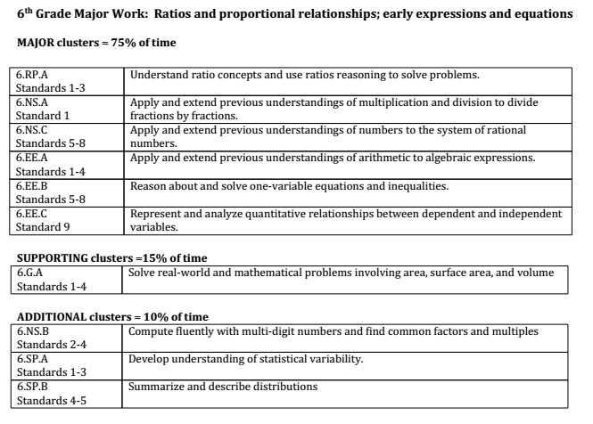
Notes:
SBA Blueprints and Content Specification
Achieve the Core - Achievement Partners

Slide 7
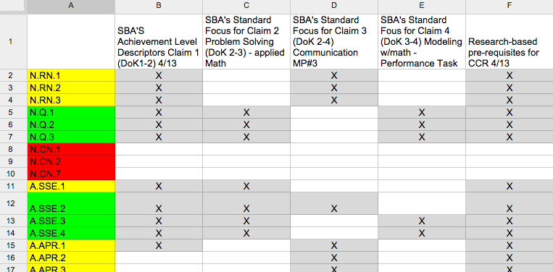
Notes:
Mark Freed - Math Education Specialist

Slide 8
As you look through the Focus Content documents (pg 1-3), put an arrow next to the clusters that you feel are stand alone, discrete skills (i.e. 6.SP.A Develop understanding of statistical variability)
Notes:
pg 1-3
Whole Group share out - one example from each grade level

Slide 9
As you look through the Focus Content documents, put an arrow next to the clusters that you feel are stand alone, discrete skills (i.e. 6.SP.A Develop understanding of statistical variability)
Private think time –
How would you teach differently if what you currently think of as a discrete skill was seen as a support of the focus area?
Notes:
Whole Group share out - one example from each grade level

Slide 10
As you look through the Focus Content documents, put an arrow next to the clusters that you feel are stand alone, discrete skills (i.e. 6.SP.A Develop understanding of statistical variability)
Private think time –
How would you teach differently if what you currently think of as a discrete skill was seen as a support of the focus area?
In partners:
Give an example of how you would approach the topic differently in your teaching if you thought of it as supporting the major work, instead of being a separate discrete topic.
Since _______ is the focus of our work in ____ grade, I will approach the topic of _____ by ...
**Whole Group Share out
Notes:
Whole Group share out - one example from each grade level

Slide 11
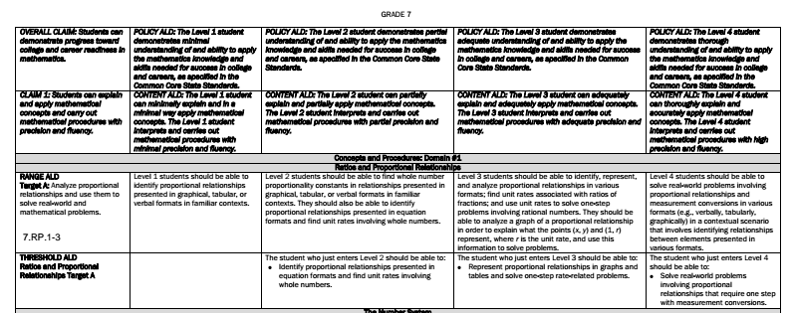
Claim 1: How deep?
Achievement Level Descriptors
Domain 1 = Major Topics
Domain 2 = Supporting
Claim Description
Standards
Assessment Target (Cluster in Claim 1)
Bulleted summary of domain
Level 3 = Proficient
Notes:
12:45pm
Explain structure
Descriptors for each target (cluster) – Discern btwn target letters and cluster letters – have visual of each? – Thresh hold ALDs for each content category
6th grade - pg 4 - 7, 7th grade - pg 8 – 11, 8th grade - pg 12 - 15, 11th grade - pg 16 – 20

Slide 12
Work by yourself or with a partner
Find a cluster you’ve taught in the last 2 weeks.
Did you teach to a level 3?
Find a cluster you will be
teaching soon.
Determine the depth you
will need to teach.
How does it compare to
what you were thinking
before seeing this document?

Slide 13
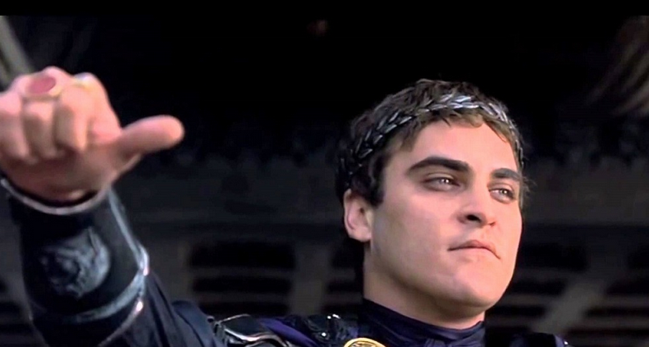
Whip around your group
I will be teaching target ______ next. I will need to teach (deeper/as deep/not as deep) as I originally thought.

Slide 14
Target
I have a clearer picture of where to focus my instruction.
Strategy #2
Close Reading with I Notice - I Wonder
Notes:
1:00pm
Close reading is an ELA instructional shift. Kids are expected to comprehend and use grade level content.
Students in math are expected to comprehend and use grade level math. Word problems are hard.
One way we can help students is to support them in noticing everything about a problem, graph, equation, etc before they even know what the question is asking them to do.
If we can help kids become more observant, they are more engaged, confident, and be performing many of the math practices.
Let’s try it with a math problem.

Slide 15
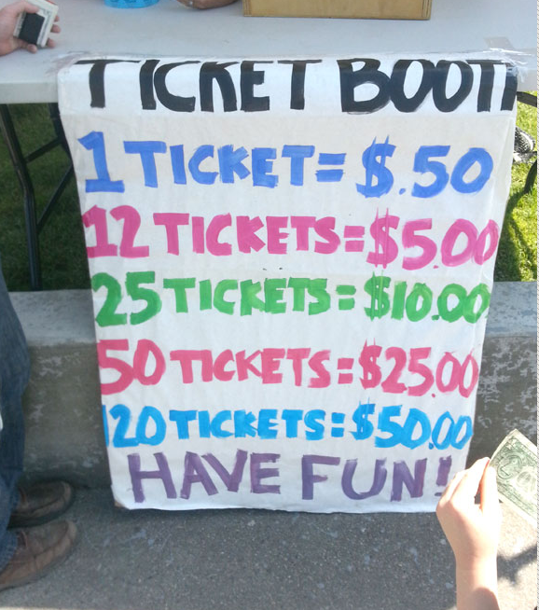
http://robertkaplinsky.com/work/ticket-option/
Notes:
What do you notice?
What do you wonder?
Write on chart paper.

Slide 16
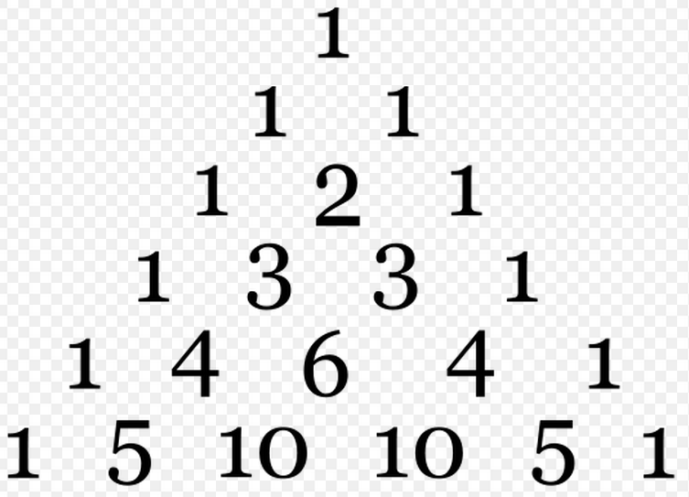
http://en.wikipedia.org/wiki/Pascal's_triangle

Slide 17
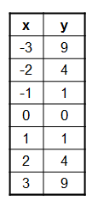
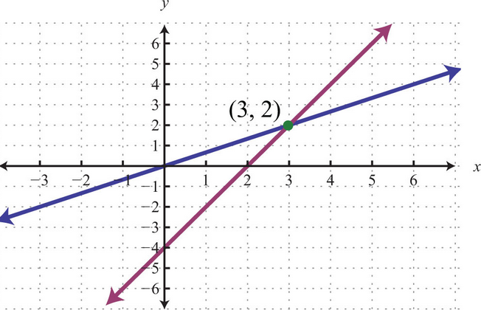
http://www.visualpatterns.org/

Slide 18
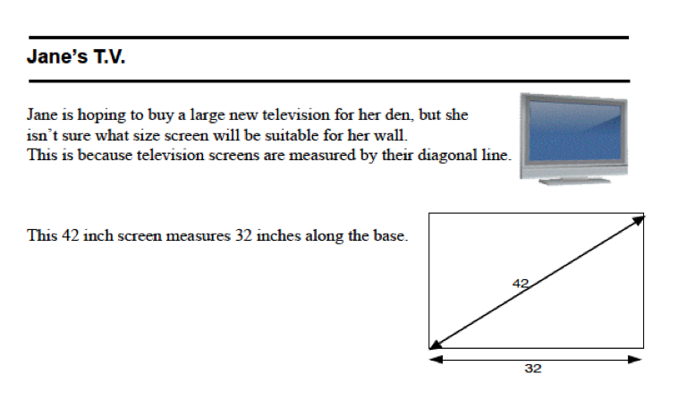
http://map.mathshell.org/materials/download.php?fileid=1098

Slide 19
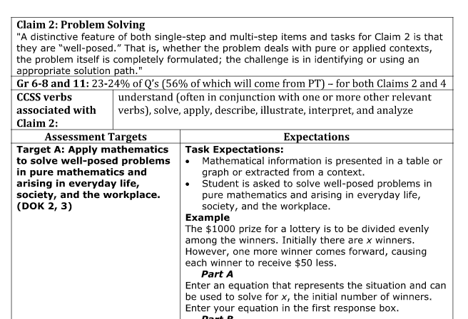
What do you notice? What do you wonder?
Notes:
Go over vocabulary, etc .
Assessment Targets
Task Expectations tell you how to present the skills
Word problems – basically
Tables tell you where to focus these word problems in your practice
On Notice/Wonder paper:
What do you notice about the focus?
What do you wonder?

Slide 20
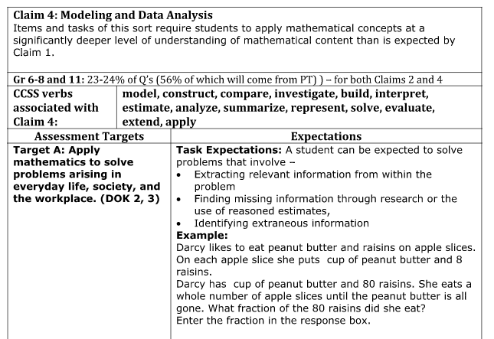
What do you notice? What do you wonder?
Notes:
Pg 26
Claims 2/4 will be scored together
What do you notice about the focus? What do you wonder?

Slide 21
Target
I have a clearer picture of where to focus my instruction.
Strategy #3
Engaging in Critical Thinking - Framing
Notes:
Sentence frames on wall – used for students to reflect on their learning. Gives processing time. Asks students to generalize in some cases.

Slide 22
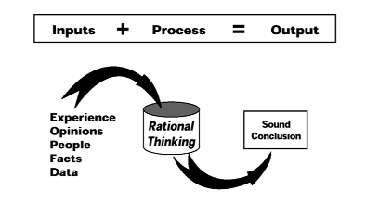
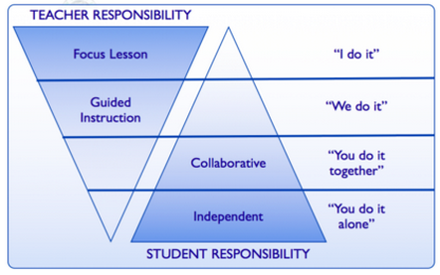
Students are:
Engaged
Processing the learning
Generalizing
It takes practice!
I do
We do
You do together
You do alone
Notes:
10/2 -
This is hard!
Simple ways to implement:
add to turn and talk or other engagement opportunities
ask students to use the frame to complete a ‘warm up’ activity
ask students to use the frame to do an ‘exit card’ or other means to close the lesson
discussion cards that could be used and made to help students practice

Slide 23
Implementation:
Warm-up
Exit card
10/2
Think, write, pair, share
Other ideas?
**Use the blue frame to talk about how understanding Claims 2 and 4 will help focus our instruction.
Since ___________________, it must ___________________.
Notes:
I do: Since students will be asked to justify their thinking, it must mean I need to model the language needed with sentence stems and frames.
We do: Since (Claim 2 is problem solving), it must (mean that I need to support kids by giving word problems to practice as a whole class and in partners.)
You do together: Type on padlet?
You do alone:

Slide 24
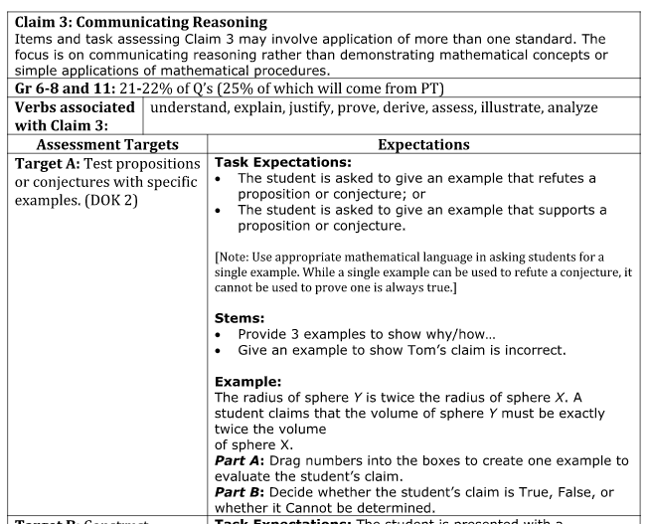
Notes:
1:20
Pg 23-25
Math practice #3: Construct viable arguments and critique the reasoning of others
Claim 3-4 Question Stems on back of Notice/Wonder paper.

Slide 25
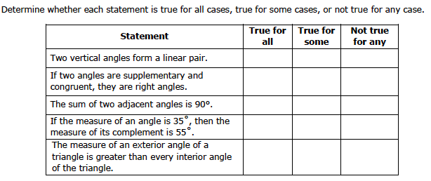
Create a quiz for the material you taught this week.
Use 1-2 stems from claim 3.
How will you ensure kids will understand how to answer the question?
Notes:
Create a quiz for the material you taught this week. Use 1-2 stems from claim 3. How will you ensure kids will understand how to answer the question?

Slide 26
Targets
I have a clearer picture of where to focus my instruction.
I have 3 strategies I can take back to my classroom that will enhance my instruction of the common core state standards.
Stemming the math talk
Close Reading with I Notice - I Wonder
Engaging in Critical Thinking - Framing
Notes:
Exit Ticket – Feedback for me
On notecard:
Choose one of the frames to reflect on this session.
Other side – question or comment. If you want dialogue with me, put your email address on the notecard.

Slide 27
Prioritizing the Common Core:
Focusing your energy where it matters in the 6-12 math classroom
January 15, 2015
Shannon Parvankin
parvankin@gresham.k12.or.us
@SParvankin

