Slide 1
CCSS & Smarter Balanced Mathematics: Key Shifts to Claims tinyurl.com/UP612math
University of Portland
1-15-15
Brian Graham
Camas School District TOSA
M.Ed. NBCT AYA Mathematics
Brian.graham@camas.wednet.edu
Notes:
Introduce my self and some of my background

Slide 2
Outcomes
Visit the three shifts for the CCSS-Math
Investigate the Smarter Balanced Assessment Claims for mathematics
Investigate the Smarter Balanced Item Types for mathematics
Reflect on the implications for instruction, assessment, and student preparation.

Slide 3
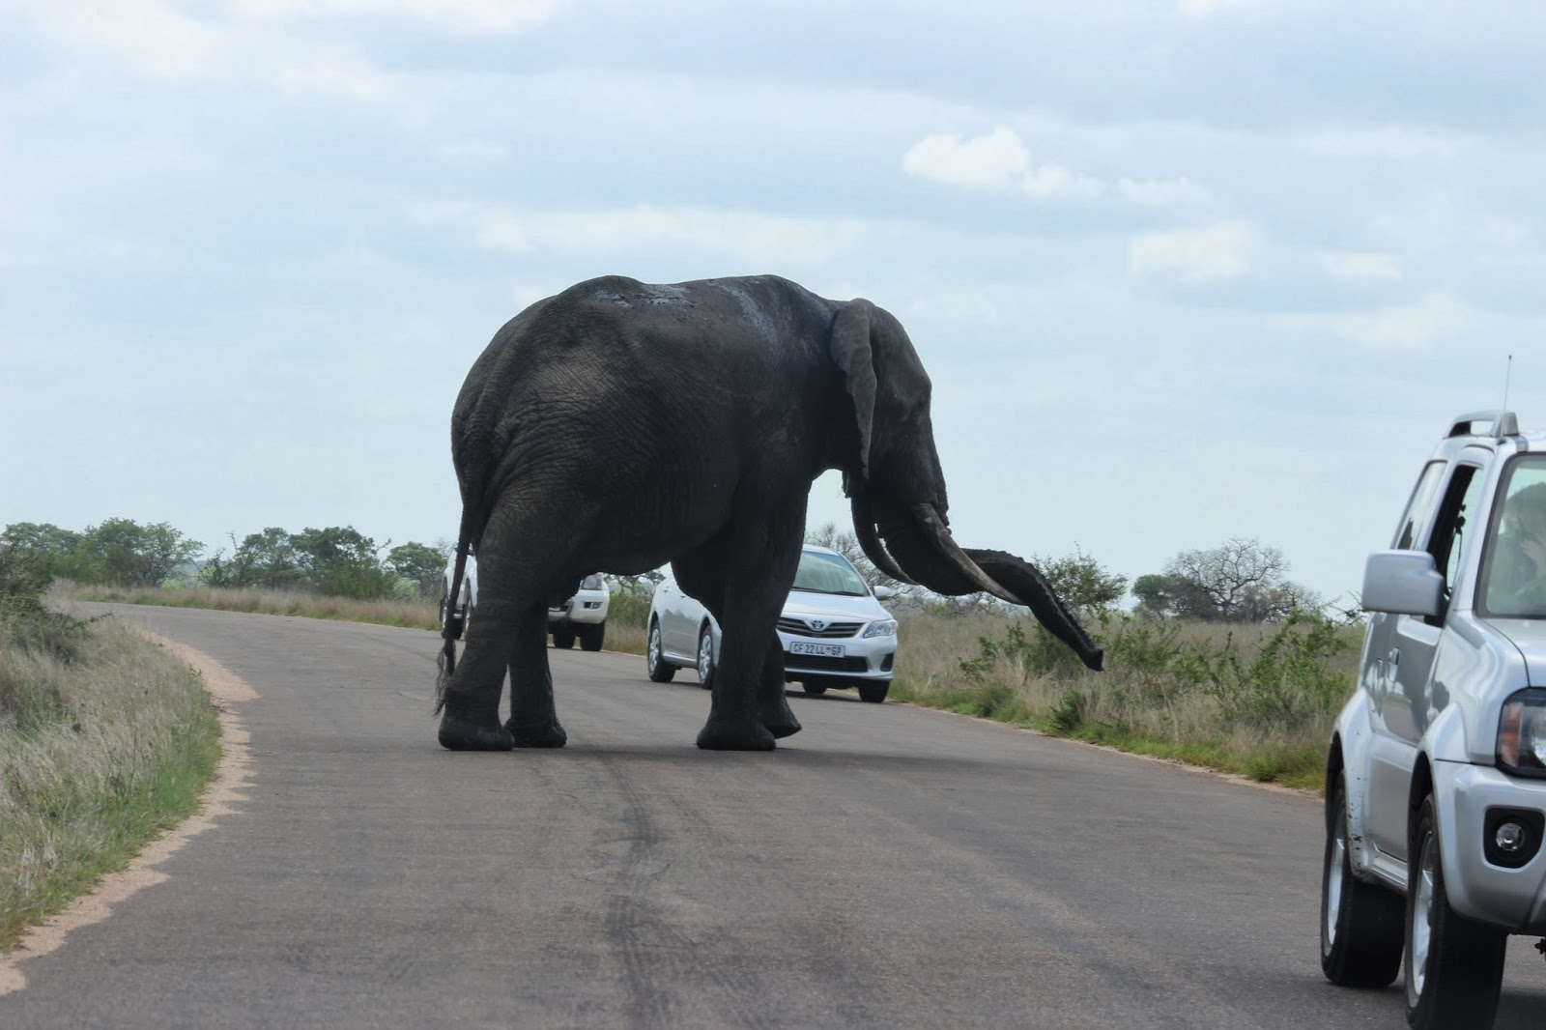
Where have we come from…
What are we doing well…
How can we enhance our practice…
“Becoming is better than being.” ― Carol S. Dweck, Mindset: The New Psychology Of Success
Notes:
Over the years we have learned how to teach skills, often times in isolation.
In the past twenty or more years there has been movement in reform based mathematics practices to teach conceptual understanding and use rich math tasks to apply learning and explore mathematics as a useful tool for understanding and describing our world.
With the number of change initiatives in place: new teacher evaluation systems, new content standards impacting our curriculum/scope and sequence, and new assessment system…give ourselves some time to learn AND keep a growth mindset. A mindset celebrating what we are doing well and enhancing our practice with the opportunity that the Common Core and SBA bring.

Slide 4
Key CCSS Shifts
Focus
Coherence
Rigor

Slide 5
Shift One: Focus strongly where the Standards focus
Significantly narrow the scope of content and deepen how time and energy is spent in the math classroom
Focus deeply only on what is emphasized in the standards, so that students gain strong foundations

Slide 6
Shift One: Focus Strongly where the Standards focus
Consider the major work within each course—this should guide your instruction for the year—not a textbook.
Teach less, learn more.
“Less topic coverage can be associated with higher scores on those topics covered because students have more time to master the content that is taught.”
– Ginsburg et al., 2005

Slide 7
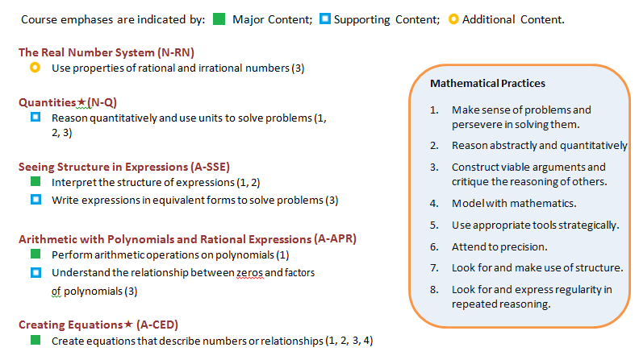
Focus By Course

Slide 8
Focus by Course http://www.k12.wa.us/CoreStandards/Mathematics/default.aspx

Slide 9
Shift Two: Coherence Think across grades, and link to major topics within grades
Carefully connect the learning within and across grades so that students can build new understanding onto foundations built in previous years.
Begin to count on solid conceptual understanding of core content and build on it. Each standard is not a new event, but an extension of previous learning.

Slide 10
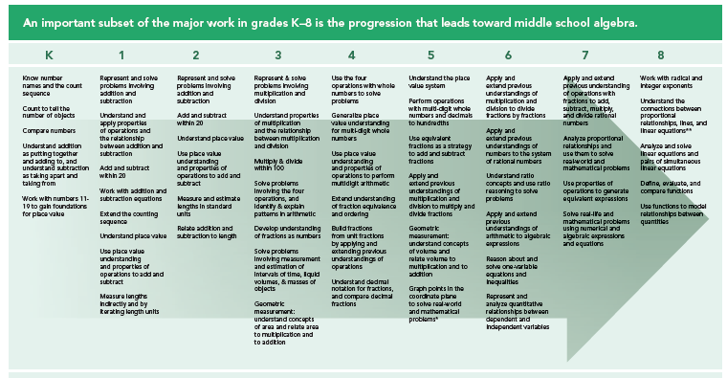
Coherence with Algebra
http://achievethecore.org/page/774/focus-by-grade-level
Notes:
An important subset of the major work in grades K-8 is the progression that leads towards middle school algebra.

Slide 11
CCSS-Math Coherence with Functions
CCSS.MATH.CONTENT.6.EE.C.9 Use variables to represent two quantities in a real-world problem that change in relationship to one another; write an equation to express one quantity, thought of as the dependent variable, in terms of the other quantity, thought of as the independent variable….
Grade 6
CCSS.MATH.CONTENT.7.RP.A.2.C Represent proportional relationships by equations. For example, if total cost t is proportional to the number n of items purchased at a constant price p, the relationship between the total cost and the number of items can be expressed as t = pn.
Grade 7
CCSS.MATH.CONTENT.8.F.B.4 Construct a function to model a linear relationship between two quantities. Determine the rate of change and initial value of the function from a description of a relationship or from two (x, y) values, including reading these from a table or from a graph. Interpret the rate of change and initial value of a linear function in terms of the situation it models, and in terms of its graph or a table of values.
Grade 8
Construct and compare linear, quadratic, and exponential models and solve problems.
CCSS.MATH.CONTENT.HSF.LE.A.1 Distinguish between situations that can be modeled with linear functions and with exponential functions.
HS
Notes:
This slide illustrates the coherent progression across grade levels from 4th to 6th grade of multiplying and dividing fractions.

Slide 12
Coherence within Grade 8
The standards make explicit connections at a single grade
CCSS.MATH.CONTENT.8.EE.B.5 Graph proportional relationships, interpreting the unit rate as the slope of the graph. Compare two different proportional relationships represented in different ways. For example, compare a distance-time graph to a distance-time equation to determine which of two moving objects has greater speed.
CCSS.MATH.CONTENT.8.F.B.4 Construct a function to model a linear relationship between two quantities. Determine the rate of change and initial value of the function from a description of a relationship or from two (x, y) values, including reading these from a table or from a graph. Interpret the rate of change and initial value of a linear function in terms of the situation it models, and in terms of its graph or a table of values.
CCSS.MATH.CONTENT.8.SP.A.3 Use the equation of a linear model to solve problems in the context of bivariate measurement data, interpreting the slope and intercept. For example, in a linear model for a biology experiment, interpret a slope of 1.5 cm/hr as meaning that an additional hour of sunlight each day is associated with an additional 1.5 cm in mature plant height.
Notes:
Make intentional connections between standards in different domains in the grade level. Help students see how the mathematics is connected.

Slide 13
8th Grade – Linear Functions
8th Algebra is deep dive into Linear Functions
Implications—
Collaborate with Middle School teachers
Alg 1 in 8th grade—what comes before??
All students need strong foundation in Linear Functions

Slide 14
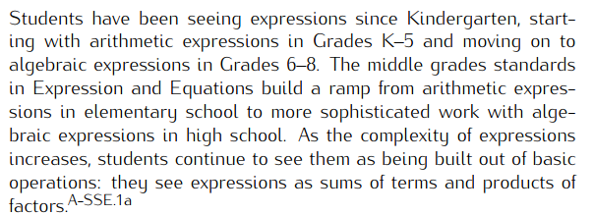
Progression Documents High School, Algebra
Seeing Structure in Expressions
Seeing structure in expressions entails a dynamic view of an algebraic expression, in which potential rearrangements and manipulations are ever present.
Notes:
Change to HS PD – Functions Modeling Algebra Stats

Slide 15
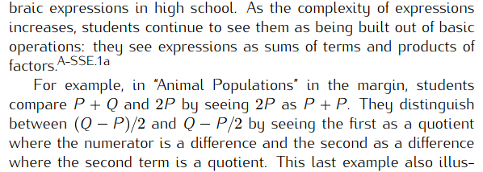
How are the Progressions helpful?

Slide 16
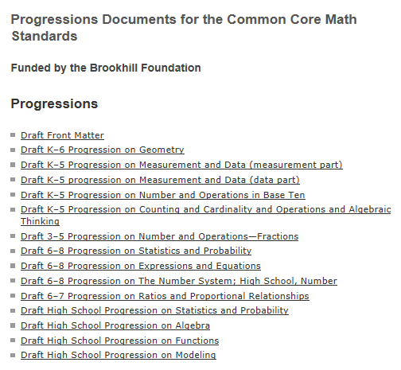
Progression Documents
http://ime.math.arizona.edu/progressions/

Slide 17
Shift Three: Rigor Equal intensity in conceptual understanding, procedural skill/fluency, and application
This requires equal intensity in time, activities, and resources in pursuit of all three

Slide 18
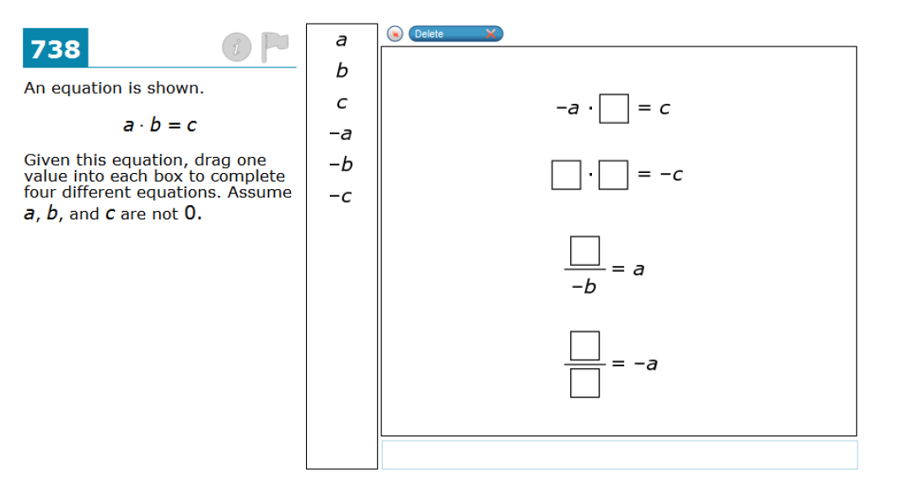
Conceptual Understanding

Slide 19
Fluency
The standards require speed and accuracy in calculation.
Teachers structure class time and/or homework time for students to practice core functions such as solving equations so that they are more able to understand and manipulate more complex concepts.

Slide 20
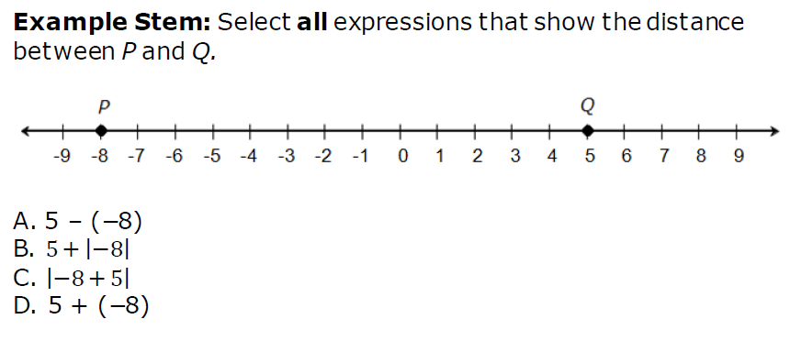
Fluency Beyond the Facts 7th grade

Slide 21
Fluency Beyond the Facts

Slide 22
Application
Students can use appropriate concepts and procedures for application even when not prompted to do so
Provide opportunities at all grade levels for students to apply math concepts in “real world” situations, recognizing this means different things in K-5, 6-8, and HS
Teachers in content areas outside of math, particularly science, ensure that students are using grade-level-appropriate math to make meaning of and access science content
Notes:
Some important ideas to keep in mind about application.

Slide 23
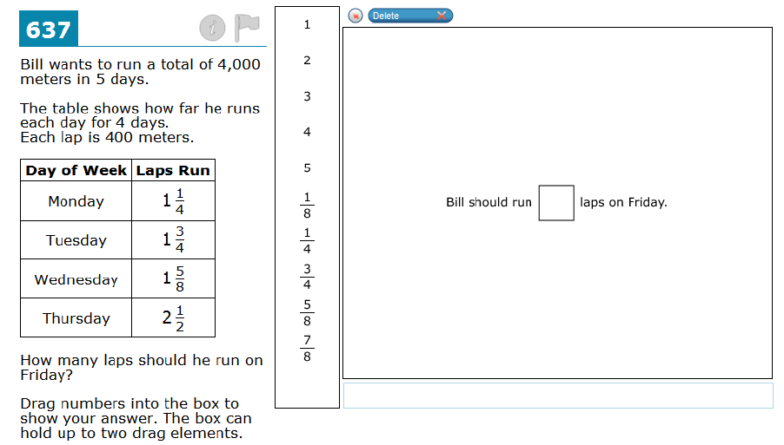
Application

Slide 24
Consider the Math
Which aspects of rigor does this task support and why?
Notes:
Which aspects of rigor does this task support and why?

Slide 25
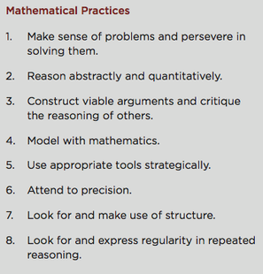
Standards for Mathematical Practice
Describes mathematical “habits of mind” that students at ALL levels should develop.

Slide 26
Activity
Turn to a neighbor:
Explain in your own words, what are the three shifts in the CCSS and how they will influence instructional practice.
Focus – Coherence - Rigor

Slide 27
Operationalizing the CCSS Shifts
Do:
Read the standards including critical areas of focus. Know the structure of the standards.
Know the major, supporting and additional clusters for your grade.
Study the progression documents with colleagues.

Slide 28
Resources
Critical Areas of Focus included in the introduction of each set of grade level standards.
Major, Supporting, & Additional Clusters
6-8 Cluster Document
HS Cluster Document
The Progressions
Notes:
Links for resources

Slide 29
The Claims

Slide 30
Assessment Claims
Claim 1 – Concepts & Procedures
“Students can explain and apply mathematical concepts and interpret and carry out mathematical procedures with precision and fluency.”
Claim 2 – Problem Solving
“Students can solve a range of complex well-posed problems in pure and applied mathematics, making productive use of knowledge and problem solving strategies.”
Claim 3 – Communicating Reasoning
“Students can clearly and precisely construct viable arguments to support their own reasoning and to critique the reasoning of others.”
Claim 4 – Modeling and Data Analysis
“Students can analyze complex, real-world scenarios and can construct and use mathematical models to interpret and solve problems.”

Slide 31
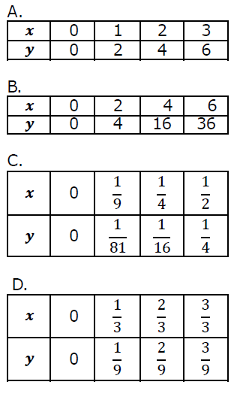
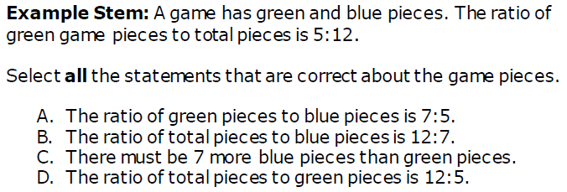
Claim 1 Concepts and Procedures
6th grade Ratios and Proportions
7th grade Ratios and Proportions
Example Stem 2: Select all tables that represent a proportional relationship between x and y.
Notes:
Examples from Task Models, Grade 4 Target, Target B [s]: Gain familiarity with factors and multiples.

Slide 32
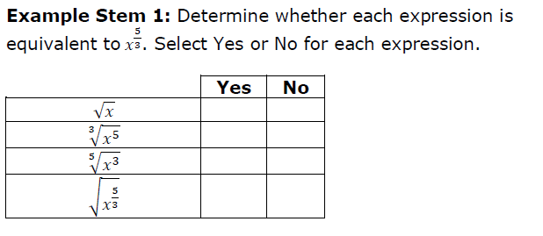
Claim 1 Concepts and Procedures
HS example N-RN.2

Slide 33
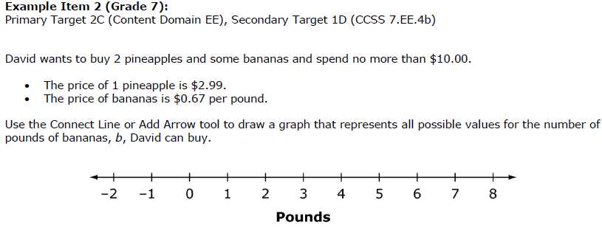
Claim 2 Problem Solving
Notes:
Claim 2, Task Model 3, item #2

Slide 34
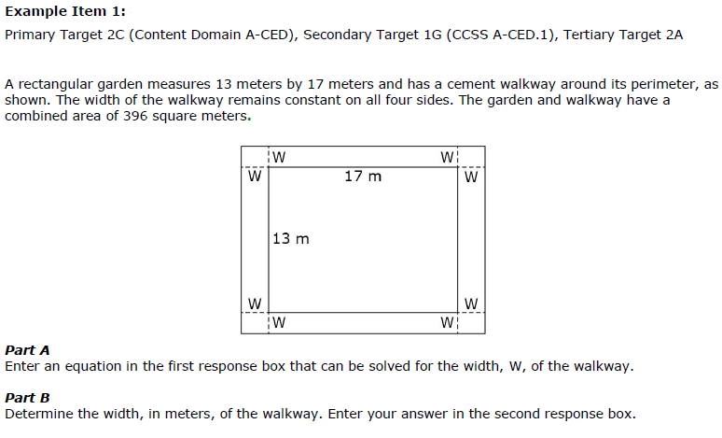
Claim 2 Problem Solving
HS Example

Slide 35
Claim 3 Communicating Reasoning

Slide 36
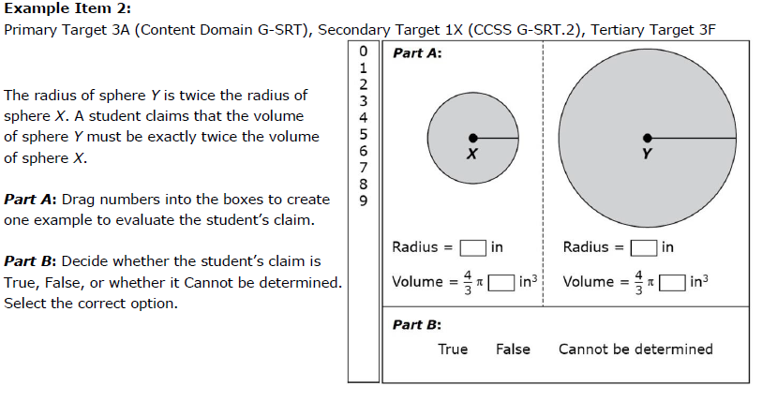
Claim 3 Communicating Reasoning

Slide 37
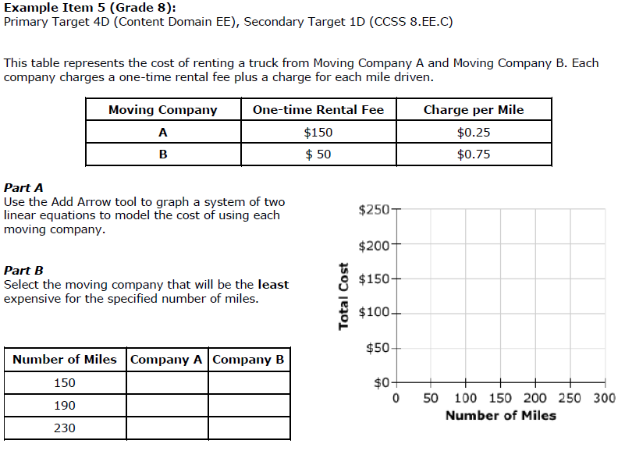
Claim 4 Modeling and Data Analysis

Slide 38
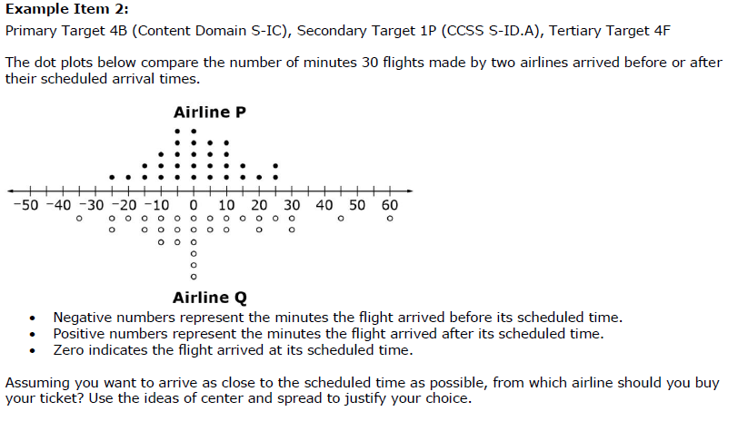
Claim 4 Modeling and Data Analysis

Slide 39
Contrasting the Claims - Activity
Individually review the items on the ‘Contrasting the Claims’ Worksheet.
Review with a partner the items by claim number.
What are the differences in the way the problems are written by claim?
How does the focus on four claims change the way you instruct and assess students in the classroom or does it?
Notes:
15-20 minutes work time followed by discussion

Slide 40
Item Types

Slide 41
CAT Item Types
Multiple Choice
Single correct answer
Multiple correct answers
Equation/Numeric
Matching Table
Fill-in Table
Grid Items
Drag and Drop
Graphing
Hot Spot

Slide 42
Multiple Choice – single correct response
Grade 6

Slide 43
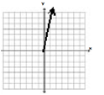
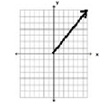
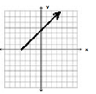
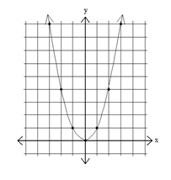
Multiple Choice – multiple correct responses
A)
B)
C)
D)
Grade 8
Select all the graphs that show a proportional relationship.

Slide 44
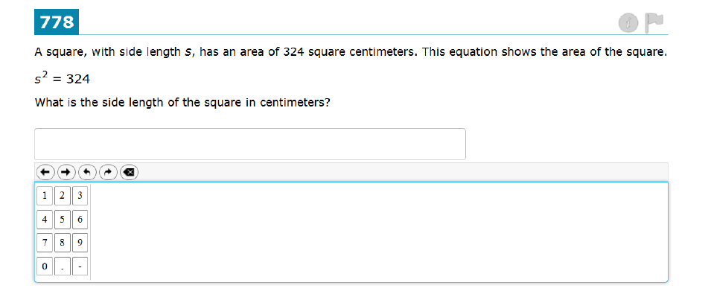
Equation/Numeric

Slide 45
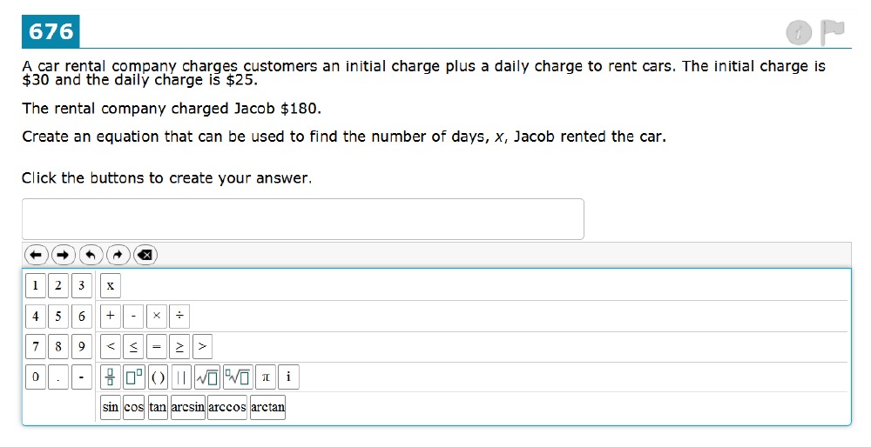
Equation/Numeric Grade 11

Slide 46
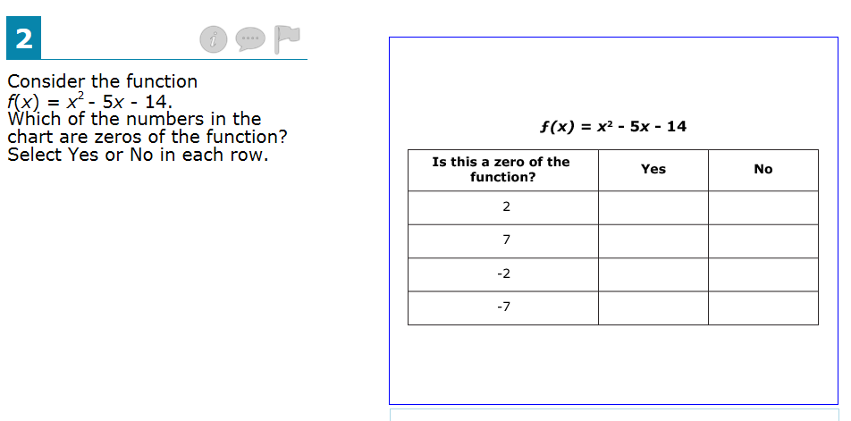
Matching Table
Grade 11

Slide 47
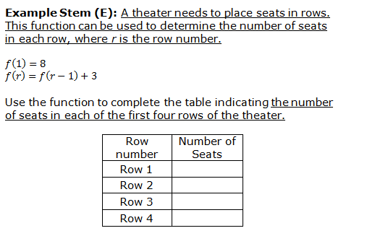
Fill- in Table

Slide 48
Drag and Drop
Grade 8
Kayla asked 10 students in her class whether they owned a dog or a cat or both.
Drag one number into each box to complete the table, given this information:
40% of the students own a dog.
30% of the students own a cat.
10% of the students own both a dog and a cat.

Slide 49
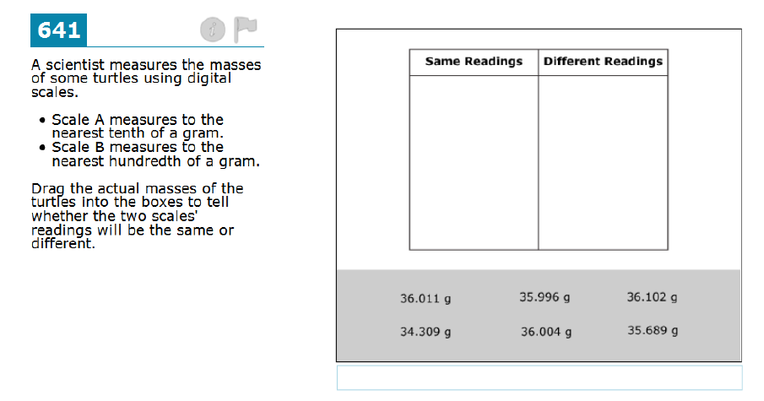
Drag and Drop 6th grade

Slide 50
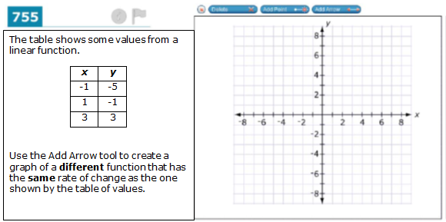
Graphing
Grade 8

Slide 51
Hot Spot
Grade 11

Slide 52
Item Type Implications
Review the ‘Item Type’ worksheet and talk to a partner about these questions. Be prepared to share your discussion:
What implications do these item types have, if any, on your instruction and assessment of students?
What resources do you have that might allow you to create similar items and imbed them in instruction and assessment?
Notes:
15-20 minutes work time followed by discussion.

Slide 53
Depth of Knowledge

Slide 54
Cognitive Rigor and Depth of Knowledge
Level of complexity of cognitive demand
Level 1: Recall and Reproduction
Requires eliciting information such as a fact, definition, term, or a simple procedure, as well as performing a simple algorithm or applying a formula.
Level 2: Basic Skills and Concepts
Requires the engagement of some mental processing beyond a recall of information.
Level 3: Strategic Thinking and Reasoning
Requires reasoning, planning, using evidence, and explanations of thinking.
Level 4: Extended Thinking
Requires complex reasoning, planning, developing, and thinking most likely over an extended period of time.
Notes:
Smarter Balanced items and tasks will elicit evidence that students have the ability to integrate knowledge and skills across multiple assessment targets and are ready to meet the challenges of college and careers.
{+}
Items and tasks must be constructed at various levels of cognitive rigor. Smarter Balanced has defined four levels of depth of knowledge.
{+}
The first level focuses on recall and reproduction of facts and other types of information.
{+}
The second level focuses on basic skills and concepts that require cognitive processes that extend beyond the recall of information.
{+}
The third level focuses on strategic thinking and reasoning.
{+}
The fourth and final level requires extended thinking that includes complex reasoning, planning, development, and cognition that occurs over an extended period of time.
Let’s take a look at a sample item for each of the four levels of depth of knowledge.

Slide 55
Level 1 – Recall and Reproduction
·
8⁷ 8^{–12}
7⁴
7^{–3}
1
3
²
1
3
⁹
·
(–5)⁶
(–5)¹⁰
Notes:
This is a grade 8 item that is coded to depth of knowledge level one. This item requires students to recall the rules for exponents to evaluate each expression and select the expression or expressions with a value between zero and one.

Slide 56
Level 2 – Application of Skills/ Concepts
A cylindrical tank has a height of 10 feet and a radius of 4 feet. Jane fills this tank with water at a rate of 8 cubic feet per minute. How many minutes will it take Jane to completely fill the tank without overflowing at this rate?
Round your answer to the nearest minute.
Notes:
This is a grade 8 item that is coded to depth of knowledge level two. This item requires students to use the formula for the volume of a cylinder, as well as a basic understanding of rate, to calculate the number of minutes Jane will take to fill the water tank.

Slide 57
Level 3 – Strategic Thinking and Reasoning
The total cost for an order of shirts from a company consists of the cost for each shirt plus a one-time design fee. The cost for each shirt is the same no matter how many shirts are ordered.
The company provides the following examples to customers to help them estimate the total cost for an order of shirts.
50 shirts cost $349.50
500 shirts cost $2370
Part A: Using the examples provided, what is the cost for each shirt, not including the one-time design fee? Explain how you found your answer.
Part B: What is the cost of the one-time design fee? Explain how you found your answer.
Notes:
This is a grade 8 item that is coded to depth of knowledge level three. This item requires students to perform calculations in order to respond to each part. In addition, students are required to provide an explanation for each answer.

Slide 58
Level 4 – Extended Thinking
During the task, the student assumes the role of an architect who is responsible for designing the best plan for a park with area and financial restraints.
The student completes tasks in which he/she compares the costs of different bids, determines what facilities should be given priority in the park, and then develops a scale drawing of the best design for the park and an explanation of the choices made.
This investigation is done in class using a calculator, an applet to construct the scale drawing, and a spreadsheet.
Notes:
This is a description for a grade 8 performance task that is coded to depth of knowledge level four. This item requires students to use concepts of geometry, numbers and operations, and statistics to determine the best solution to a problem where all constraints cannot be satisfied at the same time. Additionally, the student must provide justifications to support reasoning. Students are expected to engage with the task for an extended period of time, up to 120 minutes.

Slide 59
Depth of Knowledge
Look at the ‘Comparing the Claims’ and determine the Depth of Knowledge level of each.
Be prepared to share.

Slide 60
Consider the CCSS Shifts, the SBA Claims, and the SBA Item Types…
What instructional/assessment shifts are you thinking about?
Considering the assessment platform and item types, what the implications for students?
How might you prepare your students for the SBA?
Notes:
Talk with a neighbor, a few share outs

Slide 61
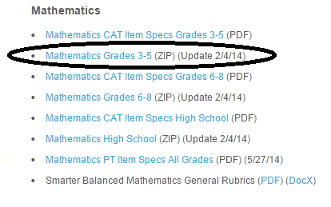
Resources
Practice Test Items/Answer Keys
http://sbac.portal.airast.org/practice-test/resources/#scoring
Smarter Balanced Test Blueprints
http://www.smarterbalanced.org/wordpress/wp-content/uploads/2014/05/Math_Preliminary_-Blueprint-2014_04-30Final.pdf
Item Writing Task Models
http://www.smarterbalanced.org/smarter-balanced-assessments/#item

