Slide 1
Envisioning
ELA Anchor Standard 6
Beaverton School District 2015
Jennifer Burkart/ Sarah Dunkin- Teaching and Learning

Slide 2
Anchor Standard 6
Assess how point of view or purpose shapes the content and style of a text

Slide 3
Reading: Informational Text: Anchor 6
English Language Arts Standards Reading: Informational Text Anchor 6
Reading Anchor 6: Assess how point of view or purpose shapes the content and style of text
K | 1 | 2 | 3 | 4 | 5
Name the author and illustrator of a text and define the role of each in presenting the idea or information in a text. | Distinguish between information provided by pictures or other illustrations and information provided by the words in a text. | Identify the main purpose of a text, including what the author wants to answer, explain, or describe. | Distinguish their own point of view from that of the author of a text. | Compare and contrast a firsthand and secondhand account of the same event or topic; describe the differences in focus and the information provided. | Analyze multiple accounts of the same event or topic, noting important similarities and differences in the point of view they represent.

Slide 4
Reading: Informational Text: Anchor 6
English Language Arts Standards Reading: Informational Text Anchor 6
Reading Anchor 6: Assess how point of view or purpose shapes the content and style of text
K | 1 | 2 | 3 | 4 | 5
Name the author and illustrator of a text and define the role of each in presenting the idea or information in a text. | Distinguish between information provided by pictures or other illustrations and information provided by the words in a text. | Identify the main purpose of a text, including what the author wants to answer, explain, or describe. | Distinguish their own point of view from that of the author of a text. | Compare and contrast a firsthand and secondhand account of the same event or topic; describe the differences in focus and the information provided. | Analyze multiple accounts of the same event or topic, noting important similarities and differences in the point of view they represent.

Slide 5
Partner Discussion: Why is this important work?
Do you think assessing an author’s point of view or purpose in writing a text is important work for our students? Why or why not?

Slide 6
Backward Planning
Where might this work lead? What might it look like?
Student project on chocolate milk
Big Birds, Big City (Hillsboro Assessment)
Opinion Writing

Slide 7
Point of View: Kindergarten
K: Name the author and illustrator of a text and define the role of each in presenting the idea or information in a text.
Author Studies
Illustrator Studies
Author / Illustrator Writing Pairs

Slide 8
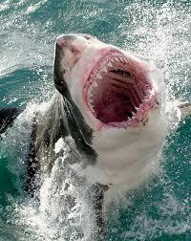
Point of View: First Grade
1st: Distinguish between information provided by pictures or other illustrations and information provided by the words in a text.
Comparing information given in pictures and information given by the text.
What did the illustrator teach us?
What did the author teach us?
Graphic Organizer 6.3
“Here are the facts. Worldwide, fewer than 100 people are attacked in an average year by sharks. Some of these cases are provoked attacked, where the shark is caught, trapped…”

Slide 9
Point of View: Second Grade
2nd: Identify the main purpose of a text, including what the author wants to answer, explain, or describe.
K/1
role of the author illustrator
2-5
author’s purpose

Slide 10
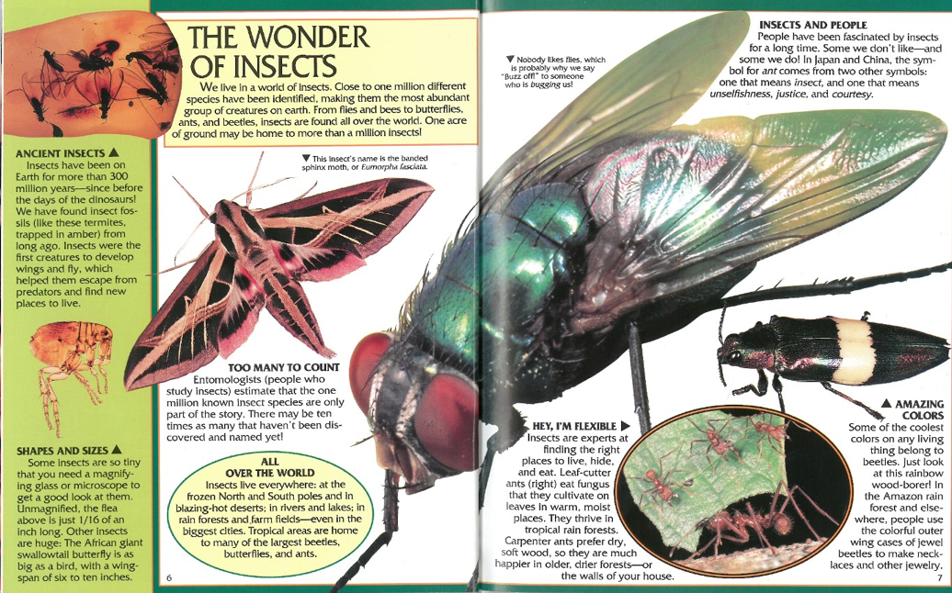
What does the author John Grassy want you to learn about bugs?

Slide 11
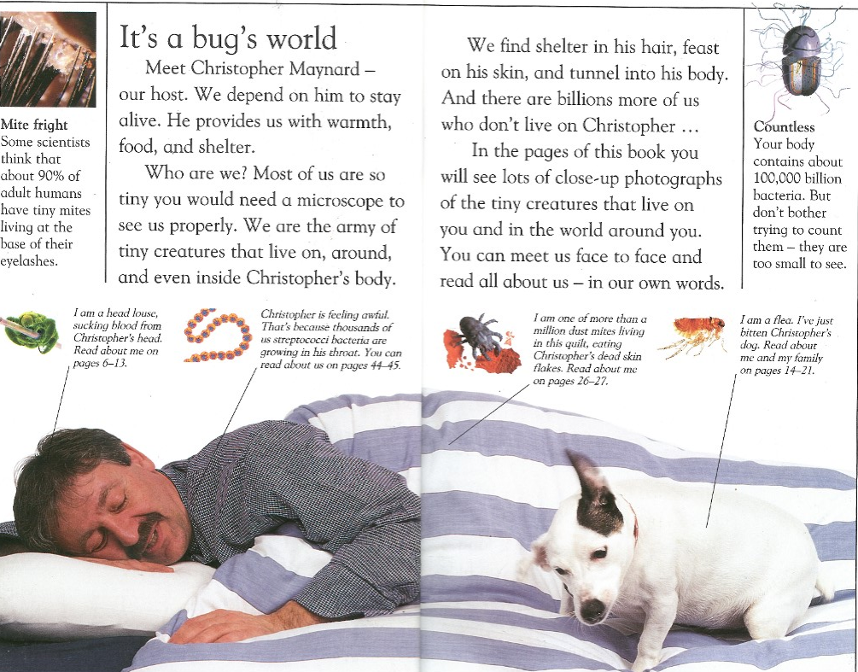
What does the author Christopher Maynard want you learn about bugs?

Slide 12
Point of View: Third Grade
3rd: Distinguish their own point of view from that of the author of a text.
Why did the author write this text?
Do you feel the same?
Let’s discuss how our point of views are similar or different from the author’s
“Considering Different Points of View” Graphic Organizer 6.5

Slide 13
Point of View: Fourth Grade
4th: Compare and contrast a firsthand and secondhand account of the same event or topic; describe the differences in focus and the information provided.
VS

Slide 14
Point of View: Fifth Grade
5th: Analyze multiple accounts of the same event or topic, noting important similarities and differences in the point of view they represent.
“Analyze” takes us one step deeper. Continue comparing points of view, but now think about the choices authors made to convey their idea. Think about why the particular author might hold that point of view

Slide 15
The Great Chocolate Milk Debate
Jamie Oliver’s Choices and Point of View
Dairy Council of Florida
USA Today Article about Chocolate Milk Ban

Slide 16
Point of View: Grade Level Lens
How might this work fit into your current model for teaching ELA?

