Slide 1
ENGLISH LANGUAGE PROFICIENCY STANDARDS
Notes:
Anna Introductions
Play “that me” to gauge who is in the audience.
Elementary teacher, middle school, teacher, high teacher, admin, esl teachers
Chart paper with stickies- years of experience, familiarity with standards, (put name and role on sticky)

Slide 2
Check In
With your thumb, show your level of comfort with
the ELP standards.
first exposure
some previous exposure
familiar with them
Notes:
Anna I see many thumbs to the side and thumbs down.plan and then the history and background of the ELP standards.

Slide 3
Describe the context for new ELP Standards
Why new standards
Key Influences and goals
Familiarize ourselves with Oregon’s ELP Standards
Discuss opportunities for English Learners in the Common Core Reflect on the shifts in instruction necessary based on a new view of language
Session Objectives
Notes:
Anna

Slide 4
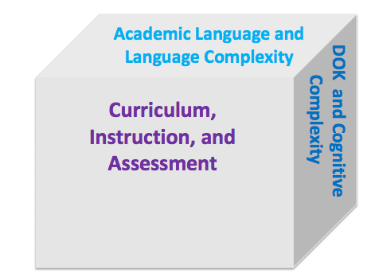
Why new ELP Standards?
College and career-ready standards contain increased language demands (results in 3-dimensional rigors in the classroom).
Notes:
Anna
In 2010 when the CCSS Standards were brought to life, it became apparent that new standards contained increased language demands. It started to become apparent that our Els were going to need more rigorous instruction to meet the goals of the CCSS.

Slide 5
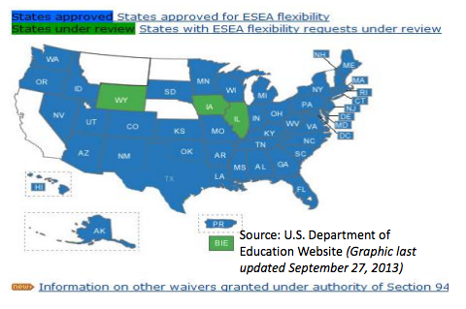
Why ELP new Standards??
NCLB flexibility waiver for Oregon required the adoption of
new English Language Proficiency (ELP) Standards which show
correspondences to CCSS.
Notes:
Anna Look at website and better explain slides more basic. Insert target slide before this slide. Delete reason 2.
Elementary and Secondary Education Act of 1965 (ESEA)
When Oregon applied for an NCLB waiver in 2012, one of the requirements Oregon had to adhere was adopting new English Language Proficiency Standards.

Slide 6
ELPA 21 Consortium
Notes:
Anna
To adhere to the NCLB Waiver requirements, Oregon joined the ELPA21 Assessment Consortium, which is made up of 11 states. These states have all adopted the same ELP Standards and will adopt the ELPA21 Assessment next year.

Slide 7
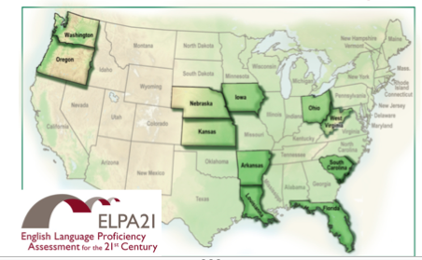
Who created the ELP Standards?
Notes:
Language Proficiency Standards were collaboratively
developed with Council of Chief State School Officers, West Ed, Stanford University’s Understanding Language Initiative,
and the states in the ELPA21 Consortium.

Slide 8
What were the goals?
Notes:
Anna

Slide 9
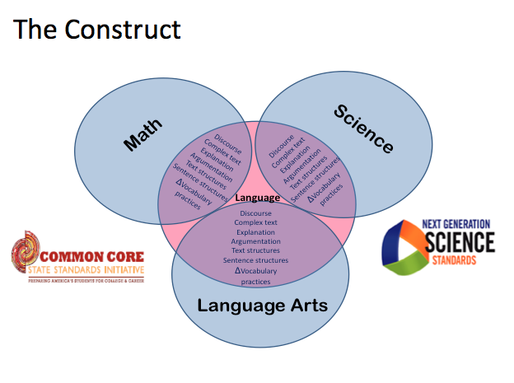
How were the ELP Standards created?
Notes:
Anna The creators of the ELP Standards found the key central language practices used with new mathematics, science, and ELA & Literacy standards to create the ELP Standards

Slide 10
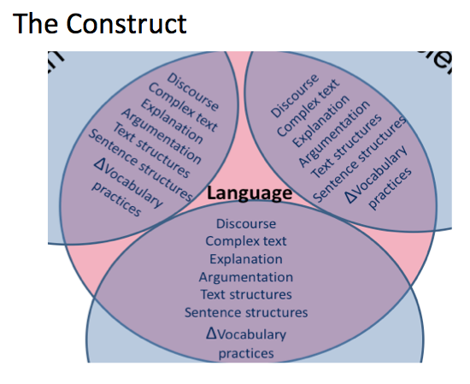
Notes:
Anna
Let’s take a closer look at these central language practice found in ELA, Math and Science. These central language practices are the basis on the ELP standards

Slide 11
Information Gap
You and your partner have the same paragraph that summarizes the previous slides.
Each paragraph has different information missing.
Without showing your partner your paragraph, find out the missing information from your paragraph.
Notes:
Anna & Leslie
Information Gap is an activity where learners are missing the information they need to complete a task and need to talk to each other to find it.
Information Gap provides opportunities around extended speaking practice and encourages the participants to work together to create meaning. During the activity, the students interact to exchange information for a real purpose—which is
exactly the way people use language in real life. The students are not merely parroting phrases and
sentences that the teacher says, nor are they asking questions to which they already know the answers.
Instead, the students are asking their own questions, giving commands, and giving and receiving information that is new to them.

Slide 12
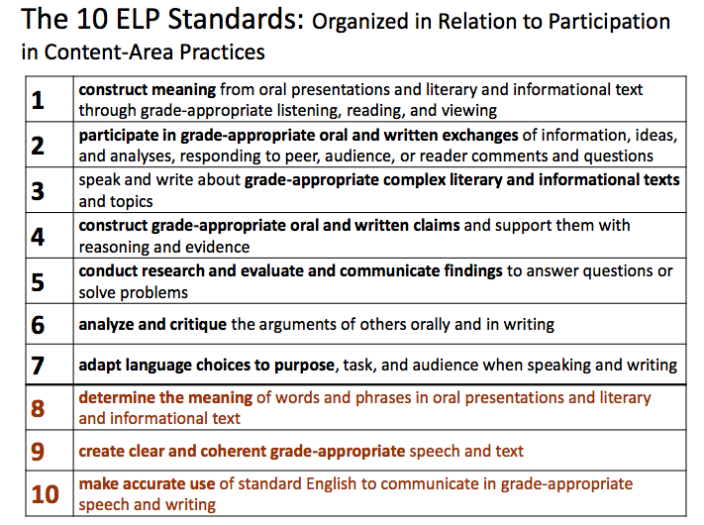
Notes:
Klarissa Have participants read aloud standards. K teachers, administers etc…..
So here they are the new ELP Standards. There are 10 standards. Notice the heading…Organized in relation to participation in content area practices. In other words, if teachers are asking students to speak, write, listen or read they can use these standards to help create access points to instruction. Standards 1 through 7 involve
the language necessary for ELLs to engage in the central content-specific practices associated with ELA & Literacy, mathematics, and science. They begin with a focus on extraction of meaning and then progress to engagement in these practices. Standards 8 through 10 hone in on some of the more micro-level linguistic features that students will need no matter the topic or content area.

Slide 13
ELP AND CCSS
Grades 4-5 English Language Proficiency Standards with Correspondences to the K-12 Practices and Grade 4 ELA Standards
By the end of each English language proficiency level, an ELL can . . .
 |  | 1 | 2 | 3 | 4 | 5
Standard 4 | An ELL can . . . construct grade-appropriate oral and written claims and support them with reasoning and evidence. | express an opinion about a familiar topic. | construct a simple claim about a familiar topic, and give a reason to support the claim. | construct a claim about familiar topics, introducing the topic and providing a few reasons or facts to support the claim. | construct a claim about a variety of topics: introduce the topic, provide several reasons or facts to support the claim, and provide a concluding statement. | construct a claim about a variety of topics: introduce the topic, provide logically ordered reasons or facts to support the claim, and provide a concluding statement.
Writing – Grade 4
Text Types and Purposes
4.W.1 Write opinion pieces on topics or texts, supporting a point of view with reasons and information. a. Introduce a topic or text clearly, state an opinion, and create an organizational structure in which related ideas are grouped to support the writer’s purpose. b. Provide reasons that are supported by facts and details. c. Link opinion and reasons using words and phrases (e.g., for instance, in order to, in addition). d. Provide a concluding statement or section related to the opinion presented.
Notes:
Klarissa Says:
On this slide, you will see a full ELP standard, standard 4. At the top you will see the grade band as well as the specific grade level. It has 5 levels, these levels match with the ELPA score for ELL students. A student who is a level 2 ELL should be able to construct a simple claim about a familiar topic and give a reason to support the claim. They are working on introducing a topic which is what is added at Level 3. Lets take a couple of minutes and compare ELP standard 4 and a CCSS 4th Grade Writing Standard. Where can you see the similarities between these standards? Highlight the similarities in the same color.
Clicks:
1.) All the levels expect students to state an opinion or make a claim.
2.) Starting at level 2, students are expected to include reasons or facts to support their claim.
3.) Starting at level 3, students are expected to introduce the topic.
4.) Starting at level 4, students are expected to provide a concluding statement.
5.) At level 5, students are expected to have logically ordered their reasons.
Big Idea/Take-away:
The ELP standards breakdown the CCSS standards to show the progression of skills in 5 levels with level 5 being the full grade-level expectations.
Notes;
You will see that 4.W.1 part c is not included in this ELP Standard. It is called out in ELP Standard 9 which you will look at on the next slide.

Slide 14
Intro To ELP Standards
Grades 4-5 English Language Proficiency Standards with Correspondences to the K-12 Practices and Grade 4 ELA Standards
By the end of each English language proficiency level, an ELL can . . .
 |  | 1 | 2 | 3 | 4 | 5
Standard 4 | An ELL can . . . construct grade-appropriate oral and written claims and support them with reasoning and evidence. | express an opinion about a familiar topic. | construct a simple claim about a familiar topic, and give a reason to support the claim. | construct a claim about familiar topics, introducing the topic and providing a few reasons or facts to support the claim. | construct a claim about a variety of topics: introduce the topic, provide several reasons or facts to support the claim, and provide a concluding statement. | construct a claim about a variety of topics: introduce the topic, provide logically ordered reasons or facts to support the claim, and provide a concluding statement.
Standard 9 | An ELL can… create clear and coherent grade- appropriate speech and text.
Communicate simple information about an event or topic, with support using non‐verbal communication and, with limited control, a narrow range of vocabulary and syntactically simple sentences.
Recount a simple sequence of events in order, and communicate simple information about a topic, with support using with emerging control, frequently occurring linking words.
Recount a short sequence of events in order, and introduce an informational topic, present one or two facts about it, and provide a concluding statement, with support using, with developing control, an increasing range of temporal and other linking words.
Recount a more detailed sequence of events, with a beginning, middle, and an end, and introduce and develop an informational topic with facts and details, and provide a conclusion, using, with increasingly independent control, transitional words and phrases to connect events, ideas and opinions.
Recount a more detailed sequence of events, with a beginning, middle, and an end, and introduce an informational topic, develop it with facts and details, and provide a concluding statement or section, using a variety of linking words and phrases to connect ideas, information, or events.
Notes:
Klarissa
Here, looking again at standard 4 and also standard 9, we can see that even visually the descriptors get longer as we move from left to right because of the progression of skills.

Slide 15
Standard 9
An ELL can… create clear and coherent grade- appropriate speech and text.
1 | 2
Communicate simple information about an event or topic, with support using non‐verbal communication and, with limited control, a narrow range of vocabulary and syntactically simple sentences.
Recount a simple sequence of events in order, and communicate simple information about a topic, with support using with emerging control, frequently occurring linking words.
Notes:
Let’s zoom in to standards 9 and look a little closer.

Slide 16
Standard 9
An ELL can… create clear and coherent grade- appropriate speech and text.
3 | 4
Recount a short sequence of events in order, and introduce an informational topic, present one or two facts about it, and provide a concluding statement, with support using, with developing control, an increasing range of temporal and other linking words.
Recount a more detailed sequence of events, with a beginning, middle, and an end, and introduce and develop an informational topic with facts and details, and provide a conclusion, using, with increasingly independent control, transitional words and phrases to connect events, ideas and opinions.
Notes:
Let’s zoom in to standards 9 and look a little closer.

Slide 17
Using the English Language Proficiency Standards, search to find the answers to the questions on your ELP Scavenger Hunt Sheet.
ELP Standards Scavenger Hunt
Notes:
Klarissa says
Now you will have the opportunity to explore the standards on your own by completing a scavenger hunt.

Slide 18
Scavenger Hunt Debrief
Find a partner.
Use the sentence starters to talk about the ELP Scavenger Hunt.
Something that stood out for me was ______.
Something I’m confused about is ______.
Something I’m wondering about is _____
Something that surprised me was ______.
Notes:
Klarissa Whole group share after debrief.

Slide 19
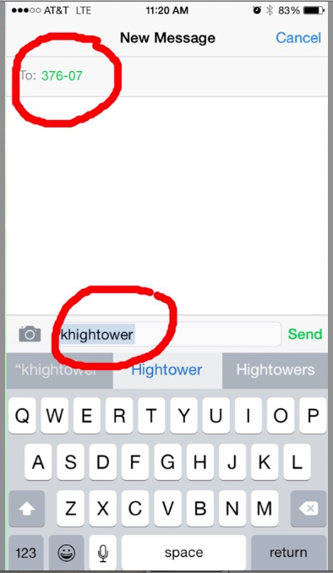
Please Text In Your Responses!
Just text to: 37607 with message khightower
Notes:
Once you have done this, you can text me your responses.

Slide 20
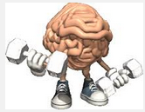
Brain Break
Notes:
Anna

Slide 21
What do the CCSS require students to do and how do they impact EL students?
Reading with Purpose
Notes:
Kerri Hello..we are going to read an article that describes in detail what educators need to consider and do in order to maximize the learning opportunities presented for EL’s by the increased language demands in the CCSS. The article is from the University of Santa Cruz and the University of Virginia and pulls from myriad language acquisition experts in the field. Because of our time constraints and the density of the article, we are going to read this in a jigsaw fashion. As you read, please focus on the question (read slide)

Slide 22
Make groups of 4. Number off in your groups from 1 to 4
Everyone Reads: Introduction and Conclusion
1s Read: Reading: Engaging with Complex Tests to Build Knowledge Across Curriculum
2s Read: Writing: Using Evidence to Inform, Argue, and Analyze
3s Read: Speaking and Listening: Working Collaboratively, Understanding Multiple Perspectives, and Presenting Ideas
4s Read: Language: Using and Developing Linguistic Resources to Do All of the Above
Realizing Opportunities for ELs in the Common Core
Notes:
Kerri Sentence starters on separate paper attached to article. Please find a group of four nearby. Number off from 1-4. Each of you will read the intro. And conclusion. 1 will read section on reading, 2 on writing, 3 on speaking and listening and 4’s language. We will give you 15 minutes or so to read. While you’re reading or after you’re done, you may want to fill out the sentence starters or have some ideas ready for when we share out. I like to write to help me process and took several pages of notes the first time I read this article.

Slide 23
Coding the Text
✔Something in the text I agree with…
? Something I wonder about….
+ Something I learned was….
Notes:
While you read, feel free to code the text with these symbols as your read your section. This will prepare you for a discussion strategy we will be engaging in after we read.
Explain spinner. In your groups, you will spin the spinner and share one of your ideas with the corresponding sentence frames. I.E. if you spin a +, you’ll use the frame to share something you learned from your section. We know you, as educated adults, know how to have academic discourse surrounding a text. However,
This is a strategy you can use with your own students when reading a text and it incorporates several of the new ELP standards. It’s just a fun way to engage your students in discussing text. Klarissa and Anna will model this for you….Please make sure each person in your group has an opportunity to spin and share…..

Slide 24
Aida Walqui Discussing a Different View of Language
Write a brief definition of what the word language means to you?
Discuss using Talking Chips:
According to Aida Walqui, how is language viewed differently under the new standards? What do you think about this?
Ask: What sort of shifts in instruction do we expect to encounter?
Listening with Purpose
Notes:
Have participants briefly write a definition. After participants write:
As an ESL teacher under the former standards, I may have written something about forms and functions or here is a dictionary definition I found: the words, their pronunciation, and the methods of combining them used and understood by a community.
We are going to watch a video where Aída Walqui, Director of Teacher Professional Development at WestEd and one of the authors of the new standards discusses how these new standards require a different view of language. As you watch the video I want you to think about how language is viewed differently under the new standards.
Answer: Language is viewed as action that encompasses both form and function. Language is action. It's impossible to separate words, sentences, from what we're doing, from the context, from with whom we are doing it, and with how we are being received.
Next we’re going to look at what sort of shifts in instruction will be necessary.

Slide 25
Instructional Shifts
From a conceptualization of
Language acquisition as an individual process
Language as a structure of functions
To understanding
Language acquistion as a social process of apprenticeship that takes place in social contexts
Language as action, subsuming structure and function (Ellis, N. Larsen-Freeman, D. 2010:van Lier & Walqui, 2012
Notes:
Have participants briefly write a definition. After participants write:
As an ESL teacher under the former standards, I may have written something about forms and functions or here is a dictionary definition I found: the words, their pronunciation, and the methods of combining them used and understood by a community.
We are going to watch a video where Aída Walqui, Director of Teacher Professional Development at WestEd and one of the authors of the new standards discusses how these new standards require a different view of language. As you watch the video I want you to think about how language is viewed differently under the new standards.
Answer: Language is viewed as action that encompasses both form and function. Language is action. It's impossible to separate words, sentences, from what we're doing, from the context, from with whom we are doing it, and with how we are being received.
Next we’re going to look at what sort of shifts in instruction will be necessary.

Slide 26
Session Objectives
1) Describe the context for new ELP Standards
Why new standards
Key Influences and goals
2) Familiarize ourselves with Oregon’s ELP Standards
3) Discuss opportunities for English Learners in the Common Core
4) Reflect on the Shifts in Instruction necessary based on a different view of language
Notes:
Leslie-Where do you feel like your best learning occurred today. Go to the corner labeled with the corresponding number and find a partner to tell Why you chose that?
Next: Which objective do you want to learn more about? Go the that number and talk about why you chose that one.
Ahead of time to Do: Label Corners
Go there

