Slide 1
CCSS & Smarter Balanced Mathematics: Key Shifts to Claims tinyurl.com/UPK5math
University of Portland
1-15-15
Brian Graham
Camas School District TOSA
M.Ed. NBCT AYA Mathematics
Brian.graham@camas.wednet.edu
Notes:
Introduce my self and some of my background

Slide 2
Outcomes
Visit the three shifts for the CCSS-Math
Investigate the Smarter Balanced Assessment Claims for mathematics
Investigate the Smarter Balanced Item Types for mathematics
Reflect on the implications for instruction, assessment, and student preparation.

Slide 3
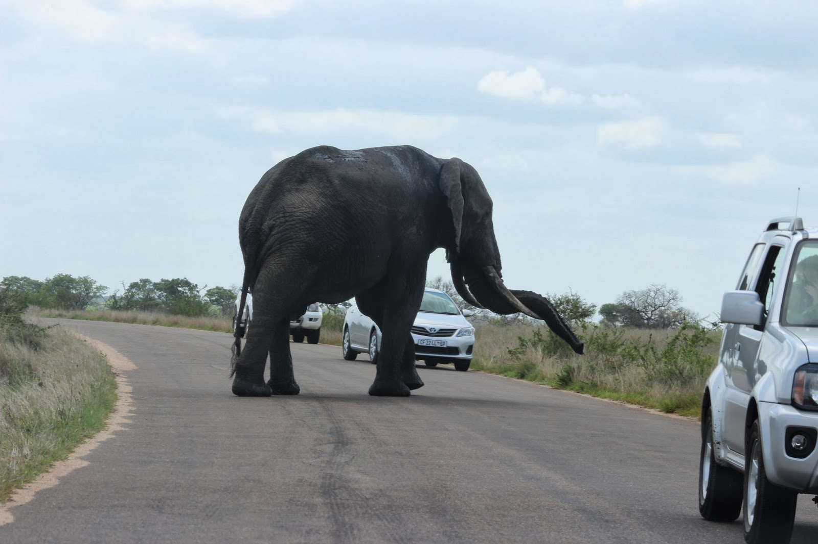
Where have we come from…
What are we doing well…
How can we enhance our practice…
“Becoming is better than being.” ― Carol S. Dweck, Mindset: The New Psychology Of Success
Notes:
Over the years we have learned how to teach skills, often times in isolation.
In the past twenty or more years there has been movement in reform based mathematics practices to teach conceptual understanding and use rich math tasks to apply learning and explore mathematics as a useful tool for understanding and describing our world.
With the number of change initiatives in place: new teacher evaluation systems, new content standards impacting our curriculum/scope and sequence, and new assessment system…give ourselves some time to learn AND keep a growth mindset. A mindset celebrating what we are doing well and enhancing our practice with the opportunity that the Common Core and SBA bring.

Slide 4
Key CCSS Shifts
Focus
Coherence
Rigor

Slide 5
Shift One: Focus strongly where the Standards focus
Significantly narrow the scope of content and deepen how time and energy is spent in the math classroom
Focus deeply only on what is emphasized in the standards, so that students gain strong foundations

Slide 6
Traditional U.S. Approach
 | K 12
Number and Operations
Measurement and Geometry
Algebra and Functions
Statistics and Probability

Slide 7
Focusing attention within ‘Number and Operations’
 | Operations and Algebraic Thinking |  |  |  |  |  |  | Expressions and Equations |  |  |  | Algebra
 |  |  |  |  |  |  | → |  |  |  | →
 | Number and Operations—Base Ten |  |  |  |  |  | → | The Number System
 |  |  |  |  |  |  |  |  |  |  | →
 |  |  |  | Number and Operations—Fractions |  |  | →
 | K | 1 | 2 | 3 | 4 | 5 |  | 6 | 7 | 8 |  | High School
Notes:
This diagram shows how CCSS domains in K-5 and 6-8 are focused to prepare students for Algebra readiness.
Inch deep and mile wide in contrast to focusing on a reduced set of standards focusing main concepts at each grade level.

Slide 8
Focusing Instruction
Notes:
3rd grade Cluster Emphasis

Slide 9
Shift Two: Coherence Think across grades, and link to major topics within grades
Carefully connect the learning within and across grades so that students can build new understanding onto foundations built in previous years.
Begin to count on solid conceptual understanding of core content and build on it. Each standard is not a new event, but an extension of previous learning.

Slide 10
CCSS-Math Coherence with Fractions
4.NF.4. Apply and extend previous understandings of multiplication to multiply a fraction by a whole number.
Grade 4
5.NF.4. Apply and extend previous understandings of multiplication to multiply a fraction or whole number by a fraction.
5.NF.7. Apply and extend previous understandings of division to divide unit fractions by whole numbers and whole numbers by unit fractions.
Grade 5
6.NS. Apply and extend previous understandings of multiplication and division to divide fractions by fractions.
6.NS.1. Interpret and compute quotients of fractions, and solve word problems involving division of fractions by fractions, e.g., by using visual fraction models and equations to represent the problem.
Grade 6
Notes:
This slide illustrates the coherent progression across grade levels from 4th to 6th grade of multiplying and dividing fractions.

Slide 11
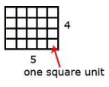
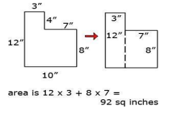
Coherence within Grade 3
The standards make explicit connections at a single grade
Multiplication and Division
Operations & Algebraic Thinking
Measurement & Data
Area
Notes:
When teaching 3rd grade one major theme is multiplication and division. The two domains Operations and Algebraic Thinking and Measurement and Data support the understanding and application of multiplication and division. There are also connections of multiplication and division in the domains of Geometry and Number & Operations Base Ten.

Slide 12
Shift Three: Rigor Equal intensity in conceptual understanding, procedural skill/fluency, and application
This requires equal intensity in time, activities, and resources in pursuit of all three

Slide 13
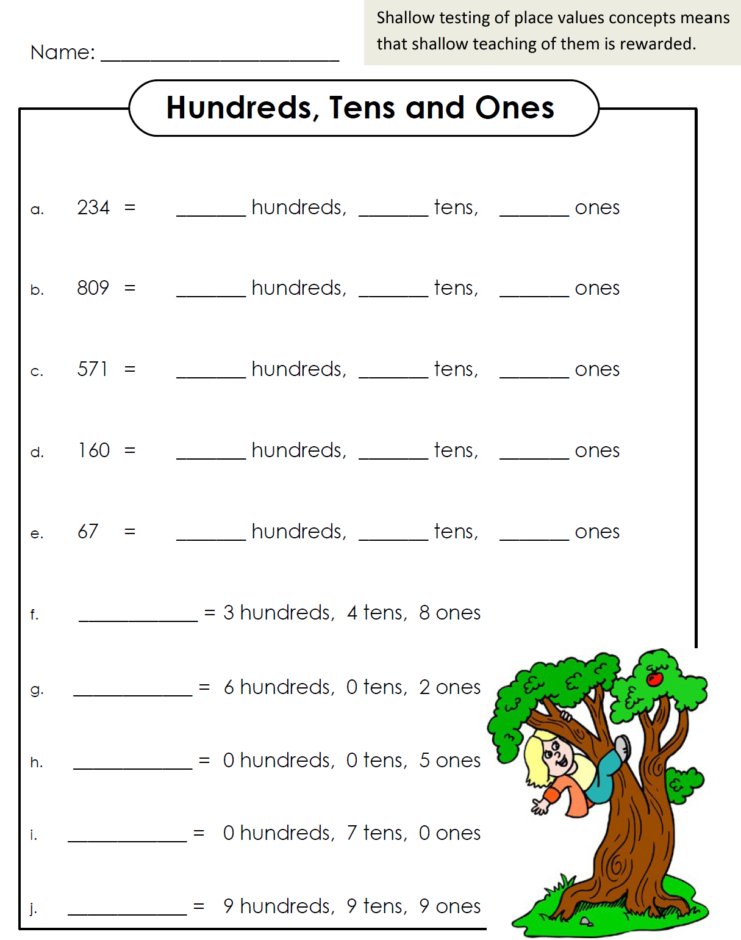
Conceptual Understanding...or is it?

Slide 14
Place Value Concepts
206 = ____ hundreds ____ tens ____ones
206 = ____ tens ____ ones
206 = ____ ones
347 = ____ tens ____ ones
452 = 3 hundreds ____ tens ____ones
521 = ____ hundreds 22 tens ____ ones
Is the comparison true or false?
12 tens + 11 ones > 1 hundred + 2 tens

Slide 15
Fluency
The standards require speed and accuracy in calculation.
The standards also required conceptual understanding beyond just facts. Strategies and mental images to understand the meaning behind skills being learning.
Notes:
Many teachers/schools/districts have used technology to support these efforts…Fastt Math, Reflex Math, other online apps.
EngageNY has “sprints” included in their daily lesson plans. One could argue, we have practiced speed and accuracy for some time. There may be a greater stretch in teaching fluency beyond just the facts.

Slide 16
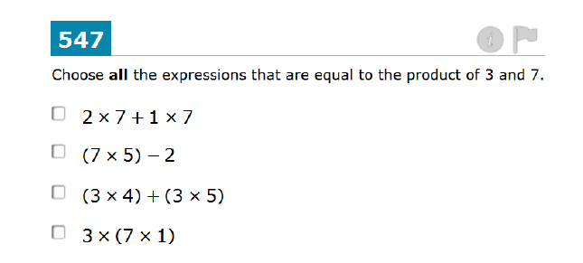
Fluency Beyond the Facts
Notes:
Consider this Smarter Balanced Task

Slide 17
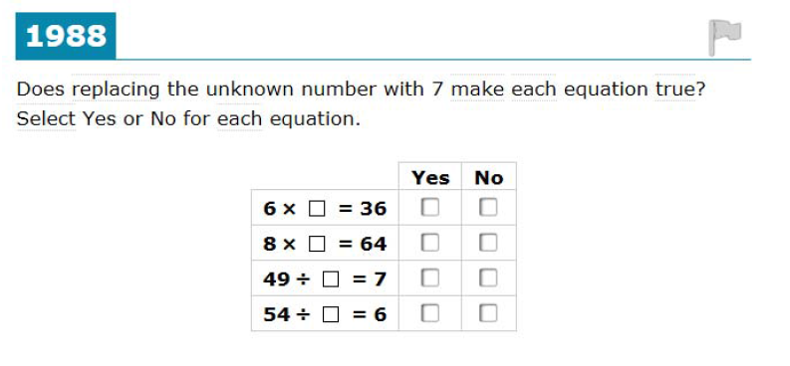
Fluency Beyond the Facts
Notes:
Consider this Smarter Balanced Task

Slide 18
Application
Students can use appropriate concepts and procedures for application even when not prompted to do so
Provide opportunities at all grade levels for students to apply math concepts in “real world” situations, recognizing this means different things in K-5, 6-8, and HS
Teachers in content areas outside of math, particularly science, ensure that students are using grade-level-appropriate math to make meaning of and access science content
Notes:
Some important ideas to keep in mind about application.

Slide 19
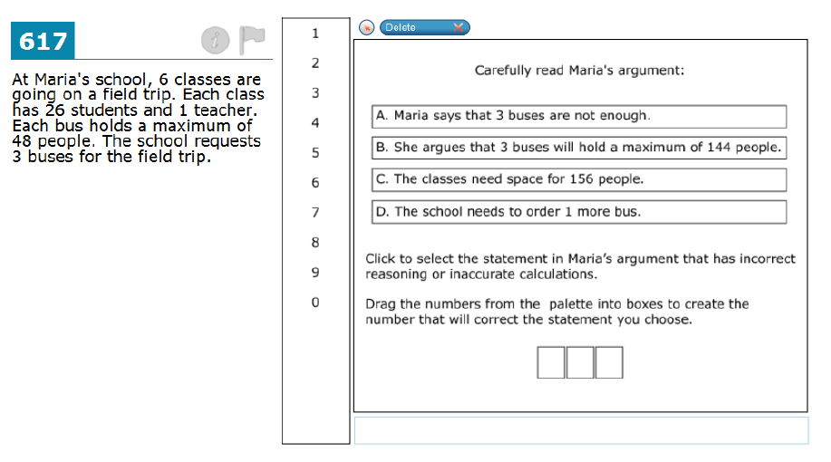
Application

Slide 20
Activity
Turn to a neighbor:
Explain in your own words what the three shifts are in the CCSS and how they will influence instructional practice.

Slide 21
Operationalizing the CCSS Shifts
Do:
Read the standards including critical areas of focus. Know the structure of the standards.
Know the major, supporting and additional clusters for your grade.
Study the progression documents with colleagues.

Slide 22
Resources
Critical Areas of Focus included in the introduction of each set of grade level standards.
Major, Supporting, & Additional Clusters
K-2 Cluster Document
3-5 Cluster Document
The Progressions
Notes:
Links for resources

Slide 23
The Claims

Slide 24
Assessment Claims
Claim 1 – Concepts & Procedures
“Students can explain and apply mathematical concepts and interpret and carry out mathematical procedures with precision and fluency.”
Claim 2 – Problem Solving
“Students can solve a range of complex well-posed problems in pure and applied mathematics, making productive use of knowledge and problem solving strategies.”
Claim 3 – Communicating Reasoning
“Students can clearly and precisely construct viable arguments to support their own reasoning and to critique the reasoning of others.”
Claim 4 – Modeling and Data Analysis
“Students can analyze complex, real-world scenarios and can construct and use mathematical models to interpret and solve problems.”

Slide 25
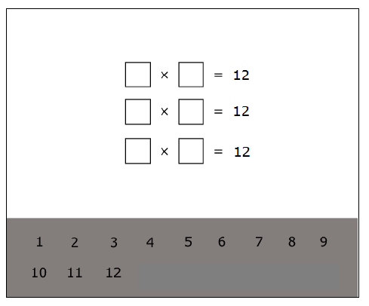
Claim 1 Concepts and Procedures
Grade 4
Example Stem: Drag numbers into the boxes to make factor pairs of 12.
Select the list of numbers that are all multiples of 8.
A. 8, 18, 24, 44
B. 8, 26, 44, 62
C. 16, 32, 48, 64
D. 40, 48, 54, 76
Notes:
Examples from Task Models, Grade 4 Target, Target B [s]: Gain familiarity with factors and multiples.

Slide 26
Claim 2 Problem Solving
Grade 3
Notes:
Claim 2, Task Model 3, item #2

Slide 27
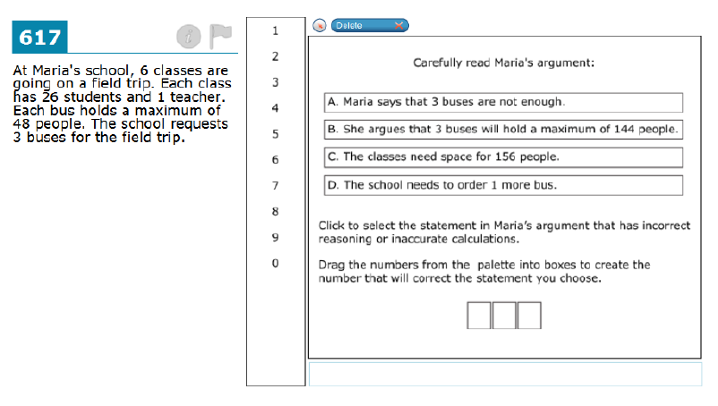
Claim 3 Communicating Reasoning

Slide 28
Claim 4 Modeling and Data Analysis
Notes:
5th grade item

Slide 29
Contrasting the Claims - Activity
Individually review the items on the ‘Contrasting the Claims’ Worksheet.
Review with a partner the items by claim number.
What are the differences in the way the problems are written by claim?
How does the focus on four claims change the way you might instruct and assess students in the classroom or does it?
Notes:
15-20 minutes work time followed by discussion
-Language from Smarter Balanced ALDS: “… student can make sense of and persevere in solving a range of complex and unfamiliar well-posed problems…”
-Consider adapting problems to

Slide 30
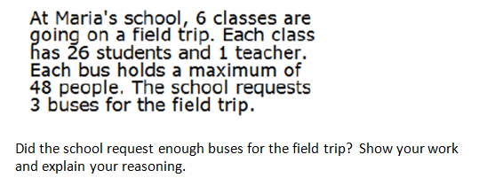
Consider Adapting Problems

Slide 31
Item Types

Slide 32
CAT Item Types
Multiple Choice
Single correct answer
Multiple correct answers
Equation/Numeric
Matching Table
Fill-in Table
Grid Items
Drag and Drop
Graphing
Hot Spot

Slide 33
Multiple Choice – single correct response
Grade 3

Slide 34
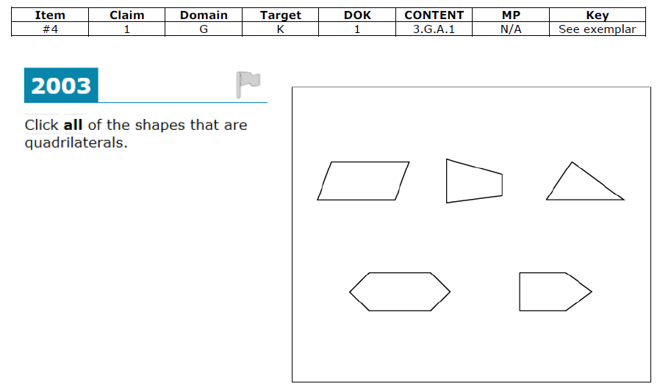
Multiple Choice – multiple correct responses

Slide 35
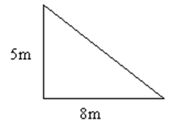
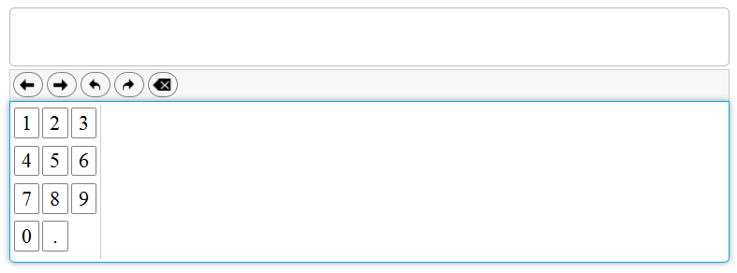
Equation/Numeric
Grade 5
A triangular-shaped garden is shown.
Enter the area of the garden, in square meters.

Slide 36
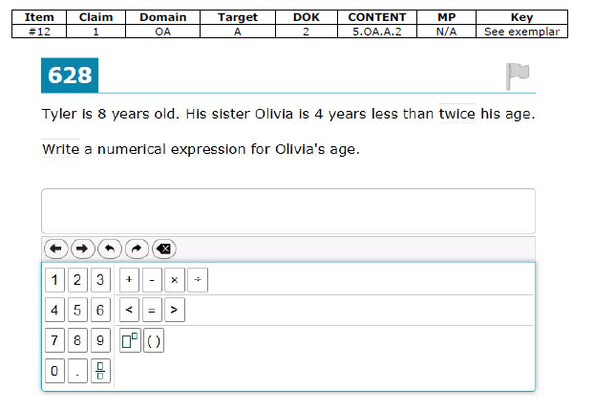
Equation/Numeric

Slide 37
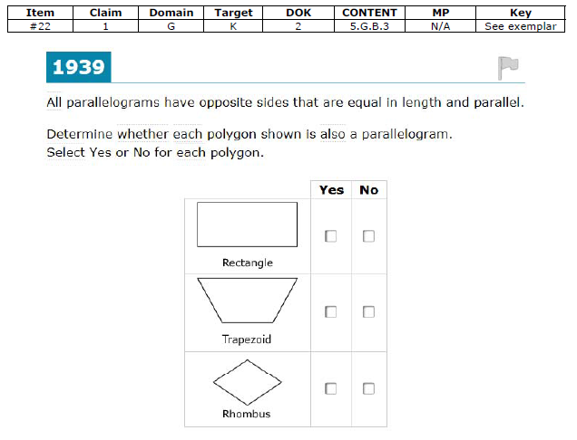
Matching Table

Slide 38
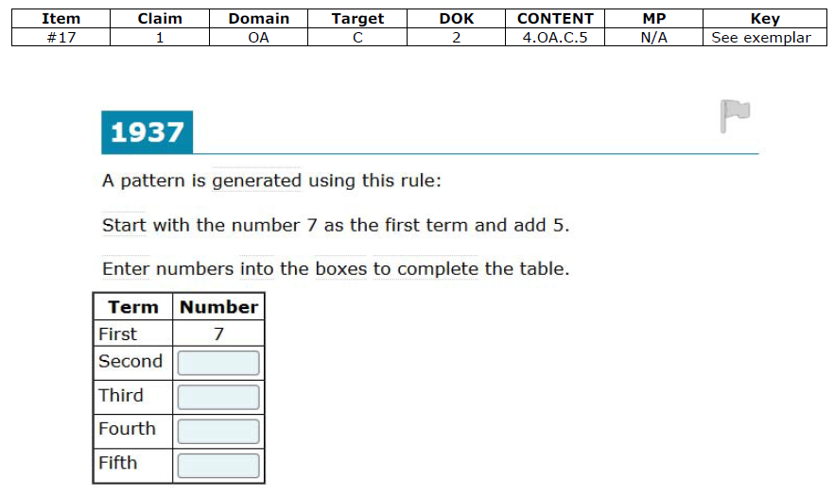
Fill- in Table

Slide 39
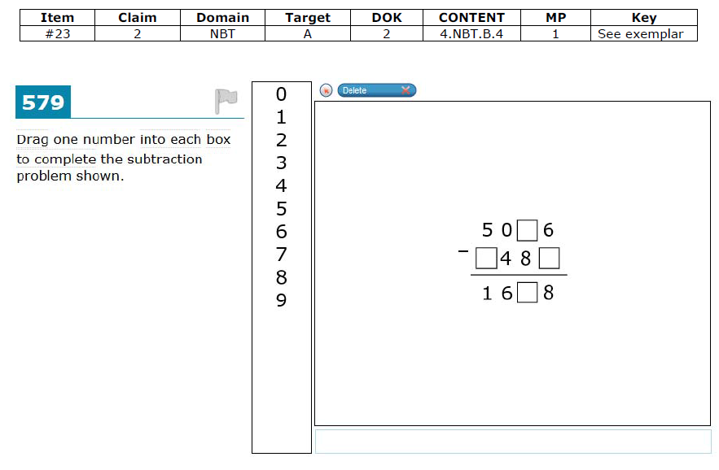
Drag and Drop

Slide 40
Drag and Drop

Slide 41
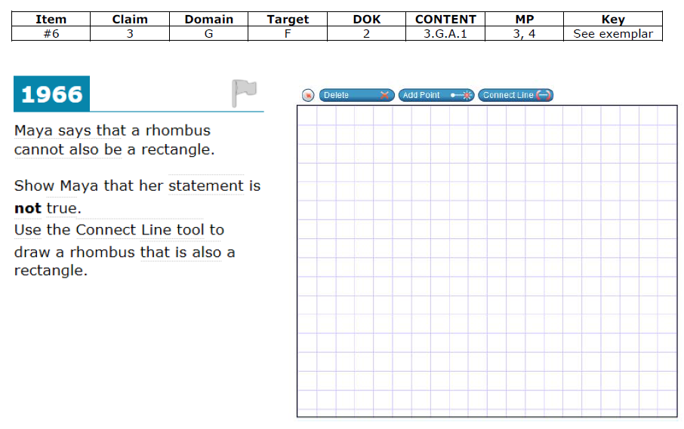
Graphing

Slide 42
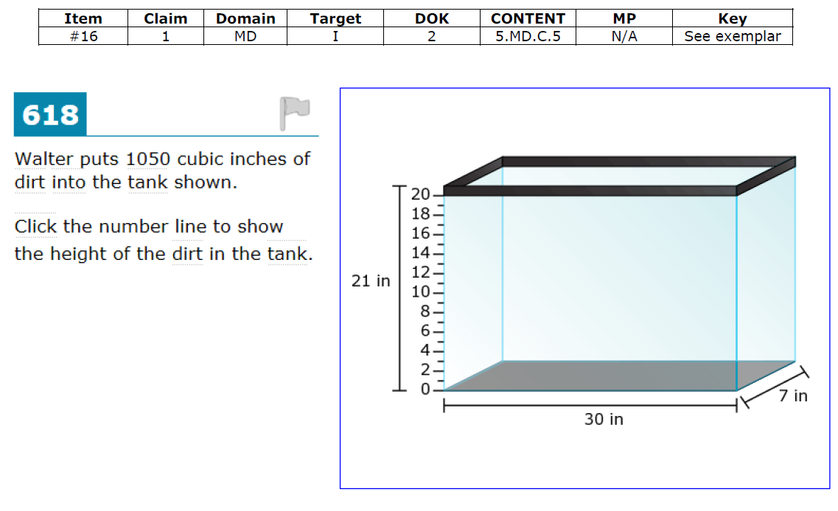
Hot Spot

Slide 43
Item Type Implications
Review the ‘Item Type’ worksheet and talk to a partner about these questions. Be prepared to share your discussion:
What implications do these item types have, if any, on your instruction and assessment of students?
What resources do you have that might allow you to create similar items and imbed them in instruction and assessment?
Notes:
15-20 minutes work time followed by discussion.

Slide 44
Depth of Knowledge
Notes:
Extra activity if time allows.

Slide 45
Cognitive Rigor and Depth of Knowledge
Level of complexity of cognitive demand
Level 1: Recall and Reproduction
Requires eliciting information such as a fact, definition, term, or a simple procedure, as well as performing a simple algorithm or applying a formula.
Level 2: Basic Skills and Concepts
Requires the engagement of some mental processing beyond a recall of information.
Level 3: Strategic Thinking and Reasoning
Requires reasoning, planning, using evidence, and explanations of thinking.
Level 4: Extended Thinking
Requires complex reasoning, planning, developing, and thinking most likely over an extended period of time.
Notes:
Smarter Balanced items and tasks will elicit evidence that students have the ability to integrate knowledge and skills across multiple assessment targets and are ready to meet the challenges of college and careers.
{+}
Items and tasks must be constructed at various levels of cognitive rigor. Smarter Balanced has defined four levels of depth of knowledge.
{+}
The first level focuses on recall and reproduction of facts and other types of information.
{+}
The second level focuses on basic skills and concepts that require cognitive processes that extend beyond the recall of information.
{+}
The third level focuses on strategic thinking and reasoning.
{+}
The fourth and final level requires extended thinking that includes complex reasoning, planning, development, and cognition that occurs over an extended period of time.
Let’s take a look at a sample item for each of the four levels of depth of knowledge.

Slide 46
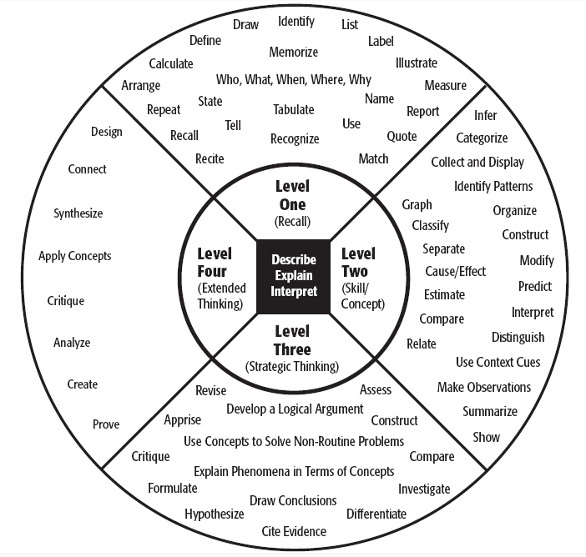

Slide 47
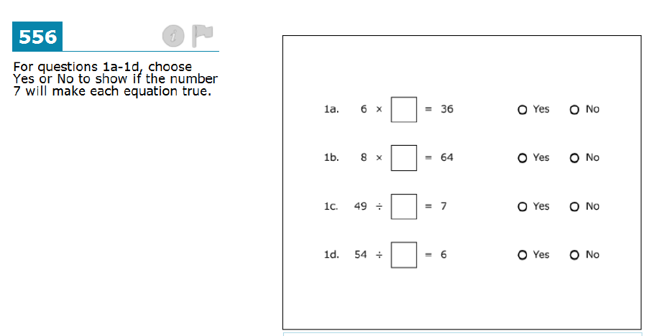
Level 1 – Recall and Reproduction
Notes:
This is a grade 8 item that is coded to depth of knowledge level one. This item requires students to recall the rules for exponents to evaluate each expression and select the expression or expressions with a value between zero and one.

Slide 48
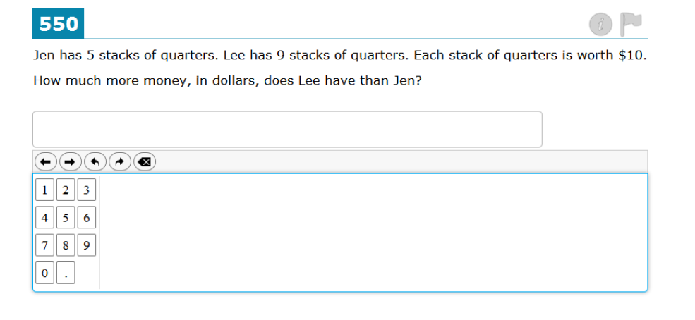
Level 2 – Application of Skills/ Concepts
Notes:
This is a grade 8 item that is coded to depth of knowledge level two. This item requires students to use the formula for the volume of a cylinder, as well as a basic understanding of rate, to calculate the number of minutes Jane will take to fill the water tank.

Slide 49
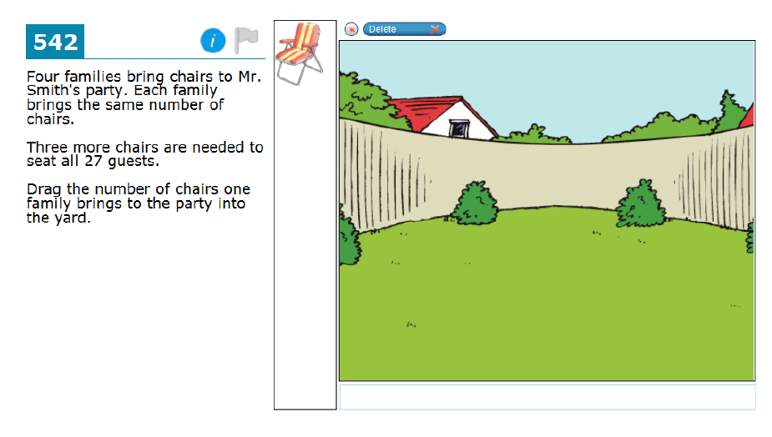
Level 3 – Strategic Thinking and Reasoning
Notes:
This is a grade 8 item that is coded to depth of knowledge level three. This item requires students to perform calculations in order to respond to each part. In addition, students are required to provide an explanation for each answer.

Slide 50
Level 4 – Extended Thinking
Notes:
This is a description for a grade 8 performance task that is coded to depth of knowledge level four. This item requires students to use concepts of geometry, numbers and operations, and statistics to determine the best solution to a problem where all constraints cannot be satisfied at the same time. Additionally, the student must provide justifications to support reasoning. Students are expected to engage with the task for an extended period of time, up to 120 minutes.

Slide 51
Depth of Knowledge
Look at the ‘Comparing the Claims’ and determine the Depth of Knowledge level of each.
Be prepared to share.

Slide 52
Consider the CCSS Shifts, the SBA Claims, and the SBA Item Types…
What instructional/assessment shifts are you thinking about?
Considering the assessment platform and item types, what the implications for students?
How might you prepare your students for the SBA?
Notes:
Talk with a neighbor, a few share outs

Slide 53
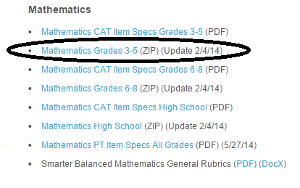
Resources
Practice Test Items/Answer Keys
http://sbac.portal.airast.org/practice-test/resources/#scoring
Smarter Balanced Test Blueprints
http://www.smarterbalanced.org/wordpress/wp-content/uploads/2014/05/Math_Preliminary_-Blueprint-2014_04-30Final.pdf
Item Writing Task Models
http://www.smarterbalanced.org/smarter-balanced-assessments/#item

